Slide 1
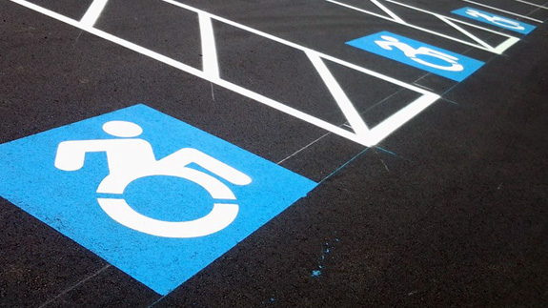
Disability Awareness
Find this resource on Clark’s Talent Development website, under Accessibility Trainings.
BUILD Project by Mike Law, Megan Jasurda, & Sandra Bush

Slide 2
Outline
Protections/rights
What is ABLEISM
How to request employee accommodations?
How to be an ally

Slide 3
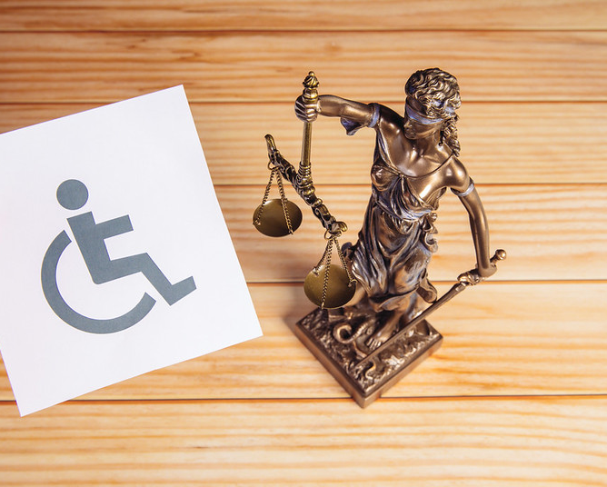
Protections & Rights

Slide 4
Intro: Prevalence of disability
ADA Amendments Act of 2008 broadened the definition and more are included.
1 in 4 Adults in US, that equates to 61 million adults.
Not everyone needs accommodation.
Most disabilities are invisible. Many people have more then one intersecting disabilities.
Notes:
Before fade in types ask 2 volunteers, or folks to put in chat, or think to themselves, what the most prevalent disability types are
Specific learning disabilities 36%
ADD or ADHD (Attention deficit hyperactivity disorder) 26%
Mental illness/psychological or psychiatric condition 13%
Health impairment/condition, including chronic conditions 11%
Examples…
If have room included prevalence stats: 1 in 5 American adults (according to US Census). And only about ½ those use accommodations.
1 in 10 Postsecondary Students (according to NCES)

Slide 5
What is disability?
ADA Defines disability and those with rights as…
"An individual with a disability is defined by the ADA as a person who has a physical or mental impairment that substantially limits one or more major life activities, a person who has a history or record of such an impairment, or a person who is perceived by others as having such an impairment. The ADA does not specifically name all of the impairments that are covered."
The ADA prohibits discrimination in employment, transportation, public accommodations, communications, access to state and local government programs and services.
Notes:
*note broadened in 2008
Brief history of disability rights – forced sterilization, institutionalization, ADA, etc.
Lay the groundwork for what took place for us to be in a place to be able to talk about disability justice
Talk about inequities in treatment/access to care
Maybe also the history of disability in the academy/access to education

Slide 6
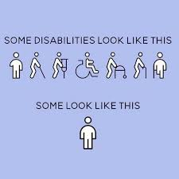
"Invisible"/Hidden Disabilities
An “invisible,” “non-visible,” “hidden,” “non-apparent,” or "unseen" disability is any physical, mental, or emotional impairment that goes largely unnoticed (invisibledisabilityproject.com).
Notes:
Parking spaces -
Bathrooms
Service animals

Slide 7
Protections of ADA
By enacting the ADA, Congress agreed that "physical or mental disabilities in no way diminish a person's right to fully participate in all aspects of society.“
Employment accommodations are under Title 1 of the ADA.
Regulated by U.S. Equal Employment Opportunity Commission (www.eeoc.gov).

Slide 8
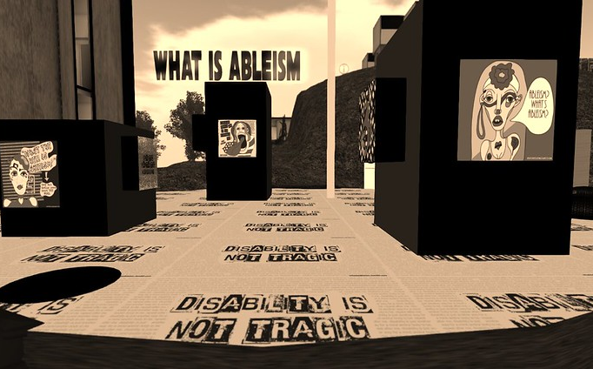
What is Ableism?

Slide 9
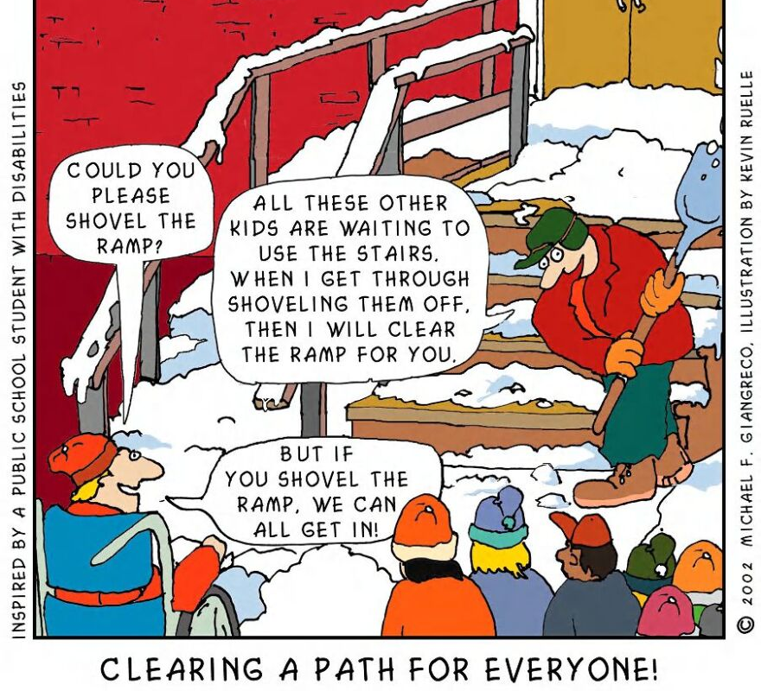
What if....... we did not have disability rights activists and we did not have the ADA?
Notes:
Children with disabilities wouldn't have support, engagement, and access in K-12. Adults with disabilities wouldn't have access in college.
Restaurants and public life wouldn't be designed for all
Workplace inequality for those with disabilities or those who acquire a disability -Educational equality- Public Accommodation – Workplace accomodation-
*No special education
*Wheelchair ramps vs. Stairs story -
*Disability stigma is a real thing that often is talked about in employment; no requirement to not discriminate, no requirement to accommodate
-before ADA folks had to pay for their own interpreters, they had to have resources or social connections to the supports they needed.

Slide 10
Ableism
A system of assigning value to people's bodies and minds based on societally constructed ideas of normalcy, productivity, desirability, intelligence, excellence, and fitness. These constructed ideas are rooted in eugenics, anti-Blackness, misogyny, colonialism, imperialism and capitalism.
This systemic oppression leads to people and society determining people's values based on their culture, age, language, appearance, religion, birth or living place, "health/wellness", and/or their ability to satisfactorily re/produce, "excel" and "behave".
You do not have to be disabled to experience ableism.
Working definition by TL Lewis, updated January 2022, developed in community with disabled Black/negatively racialized folk

Slide 11
Let's Talk About Barriers
Access
Physical spaces
Digital environments
Systemic
Policy, systems, practices, etc.
Attitudes and Assumptions
Discrimination
Ignorance
Beliefs about people within disability community
Communications/Interactions
Notes:
Discrimination – from folks who don't believe they should have to adhere to ADA, or assuming that people with disabilities are dangerous
*These barriers may connect back to the ableism (Slide 8) or microagressions presented
Ex. Classroom design
\Listen to every person. How do they want to engage with you?

Slide 12
Disclaimer
While we are going over "affirming" and "non-affirming" terms, please remember that there are variations in the disability community; the experience is not universal for every person with a disability.
Some folx may want to be addressed with "people-first" language, while others may feel this approach erases their identity and may ask for you to use identity-first language.
Ask someone how they would like to be addressed.

Slide 13
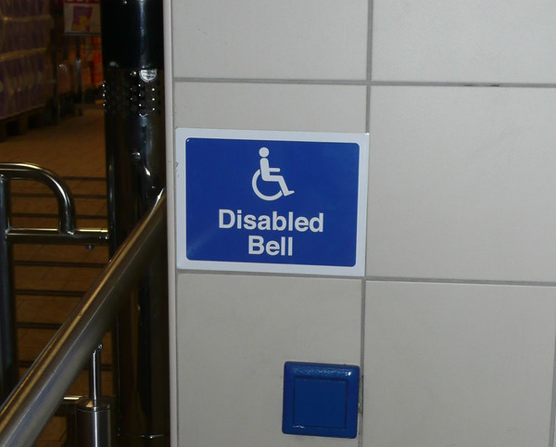
Requesting Employee Accommodations

Slide 14
Informal and Formal accommodations
Employees can talk with their supervisor to arrange informal accommodations. For example, shorter five-minute frequent breaks instead of two fifteen-minute breaks.
Seeking accommodations are optional; employees can choose to go to HR for formal accommodations.
Formal becomes a written plan with HR and supervisor assesses if it's a reasonable accommodation per the job description.
Documentation is often required unless a disability is physical or apparent, sometimes documentation isn't necessary.
Accommodations are case by case with an interactive process.

Slide 15
Employee Accommodation Examples:
Temporary leave, may be combined with FMLA leave but it depends on individual circumstances
More remote work or full-time remote work
Sign language interpreters
Fragrance free or allergy free zones
Re-configuring work space or physical access.
Temporary accommodations are possible for temporary health conditions.
Ergonomic work-station assessments are available to all employees through Environmental Health and Safety. May not be needed as a formal ADA accommodation.

Slide 16
Modifications vs. Accommodations
In employment, we are required to provide access but not modifications.
A modification would be a reduced work schedule or hours that would result in a reduction of pay.
An accommodation would be to adjust an 8 hour work shift combined with temporary leave hours.

Slide 17
How to request accommodations with Human Resources (HR)
Contact HR at hr@clark.edu
You will be invited to meet with Director of Compliance & Labor in HR and sometimes Director of Employment Services.
During the meeting you will receive:
Notification of Rights Letter
ADA Request form
HR will reach out to the medical provider you indicated with Medical Provider Information form.
Notes:
Put all forms in CANVAS

Slide 18
Need Support?
If you would like to consult with or need support as you prepare to consider requesting accommodations to HR, you are welcomed to contact Office of Diversity Equity and Inclusion (ODEI), Disability Support Services (DSS), and/or the Employees with Disabilities Resource Group (EDRG).

Slide 19
Who You Gonna Call?
Disability Support Services, www.clark.edu/dss
(360) 992-2314
Student Accommodations
Human Resources, hr@clark.edu
(360) 992-2105
Employee Accommodations
Office of Diversity, Equity, & Inclusion (ODEI)
diversity@clark.edu
Student or Staff Advocacy
Disability ERG contact info

Slide 20
Outline
Protections/rights
What is ABLEISM
How to request employee accommodations?
How to be an ally

Slide 21
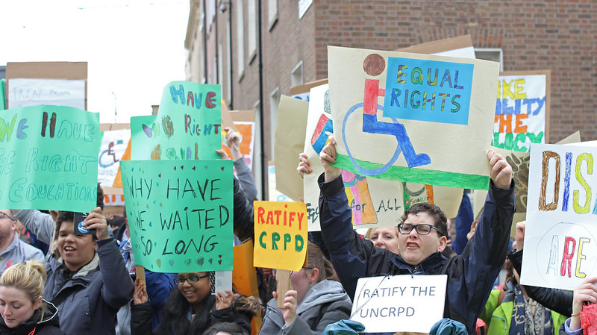
How to Be an Ally

Slide 22
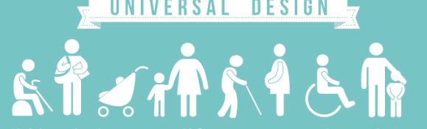
Universal Design
Design and composition of an environment that is accessible, understood and used to the greatest extent by EVERYONE regardless of their identity, age, size, ability or disability.
Notes:
What happens when we think on the forefront about what populations are excluded from design. What does this look like?

Slide 23
What can I do to be an Ally?
Review and apply the Universal Design Guide, if you are having trouble with the link, please contact DSS director for assistance.
Accessibility training with Teaching & Learning Center (TLC), DSS, or IT Accessibility Coordinator.
Think about small adjustments to increase inclusion of People With Disabilities (PWD) in your meetings, events, or lobbies. Ex. turn on automated captioning in Zoom.
When making decisions, use the Equitable Decision Making Tool and think about PWD
Seek to educate yourself
Inclusive films, research, literature (check out Research slide toward end)
Recognize difference and embrace it
Some may need accommodations; make it ok and comfortable for them to do so.

Slide 24
Misconceptions to be Aware of
Reducing disability to an unfortunate event or feeling bad for a person with a disability
Not respecting when someone has an invisible disability
Believing a person with a disability is inspirational, just for having a disability
Not creating an environment where all can engage fully
Helping a person without their permission
Asking questions about a person with a disability's personal life
Notes:
Scenarios

Slide 25
Common Problematic Phrases
"Blind as a bat"
"They have overcome their disability, they are so inspirational."
"That's so lame!"
"I'm so OCD/dyslexic/bipolar."
"Suffers from..."
Notes:
these really often are microaggressions – can ask folks unmic or chat for more phrases (crazy)

Slide 26
Tips for Interactions
Don't assume.
Don't assume someone wants you to help them
Don't assume people with disabilities want to be people without disabilities
Don't assume some tragedy happened to cause a disability
Don't touch someone's assistive device, such as a cane or service animal. Don't lean against a wheelchair.
Interact with the person you're speaking to, not their interpreter or companion.
Speak at eye level – do not stand over someone in a wheelchair and talk down to them.
Be respectful, don't stare.
Don't ask, "What happened?", especially if you do not know the person
Be kind and empathetic, you don't know how many spoons someone has left, or how many forks they have been dealing with today. Be a plate.
Notes:
EXTRA:
Add speak at eye level – don't stand over someone in a wheelchair and talk down to them

Slide 27
Reminders
Accommodations – they should know how/where to ask for them.
Not all people with disabilities are "sick"
Someone can acquire a disability at anytime (health condition, etc.)
Not all people with disabilities are inspirational
People with disabilities are leaders, community members, parents, partners and friends.

Slide 28
Every time you think about diversity, think about disability too!
"Nothing about us without us"
(slogan from 1980s disability rights movement)

Slide 29
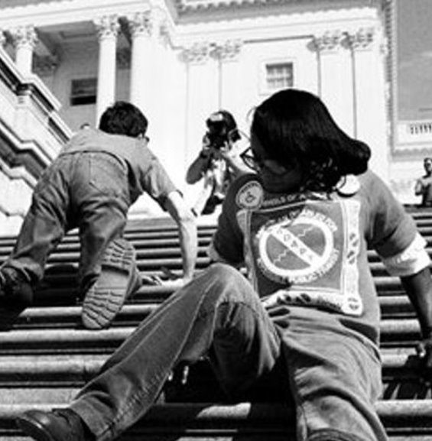
Topics to Research

Slide 30
Suggested Topics to Research
Pioneers to ADA
Foundations of Disability Justice
Medical vs. Social Model of Disability framework
Intersectionality: disability and race; disability and culture/ethnicity;
Disability identity development
Neurotypical experiences of those with Autism
Deaf Culture
Mental health stigma; mental health experiences
Barriers to healthcare access for PWD
Unemployment rates and barriers to employment
Why accessibility matters; legal cases for inaccessible technology
Universal Design

Slide 31
Resources to check out!
Attend Power Privilege & Inequity (PPI) trainings on disability topics.
Clark Accessibility Resources
Podcast: Disarming Disability
Movie: Crip Camp on Netflix
Youtube: How to be a better ally
Disability Justice topics on Talila TL Lewis website
Disability Justice topics from Lydia XZ Brown website
Disability Rights Washington: https://www.disabilityrightswa.org/
Short videos:
Disability Philanthropy Forum Conchita Hernandex Legoretta
How to Be an Ally by Daphne Frias

Slide 32
Sources
"Statue Of Lady Justice with handicapped symbol" by focusonmore.com is licensed under CC BY 2.0.
"Sun Cat Mellison: What is Ableism" by Vanessa Blaylock is licensed under CC BY 2.0.
"Disabled button" by codepo8 is licensed under CC BY 2.0.
"Disability Rights protest | Sinn Féin | Flickr" by Sinn Féin | Flickr is licensed under CC BY 2.0

