Slide 1
Notes:
All image credits courtesy of Morgue File and/or FreeImages.com unless otherwise specified

Slide 3
The meaning of oligopoly, and why it occurs
Why oligopolists have an incentive to act in ways that reduce their combined profit, and why they can benefit from collusion
How our understanding of oligopoly can be enhanced by using game theory, especially the concept of the prisoners’ dilemma
How repeated interactions among oligopolists can help them achieve tacit collusion
How oligopoly works in practice, under the legal constraints of antitrust policy
To First
Active Learning
To Video

Slide 4
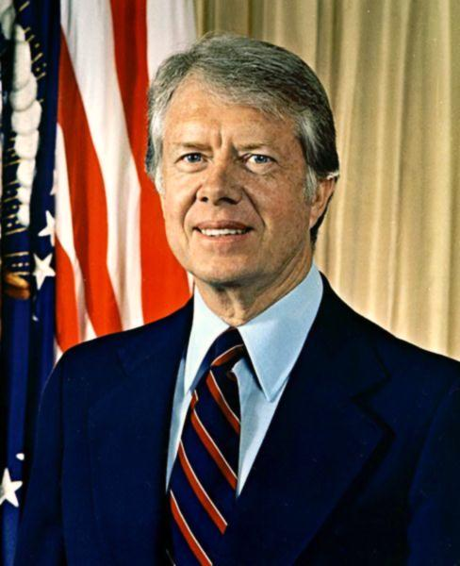
THE POWER OF OLIGOPOLY
“Our neck is stretched over the fence and OPEC has a knife.” U.S. President Jimmy Carter, 1979
Notes:
Image public domain

Slide 5
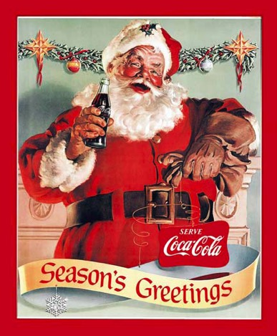
OLIGOPOLY AND MONOPOLISTIC COMPETITION
An oligopoly is a market that is dominated by a small number of firms.
(Cola)
Notes:
All image credits courtesy of Morgue File and/or FreeImages.com unless otherwise specified

Slide 6
THE LANDSCAPE OF FIRMS
YOU ARE HERE
Perfect competition
Monopolistic competition
Oligopoly
Monopoly
More competition Less competition
(less price control) (more price control)

Slide 7
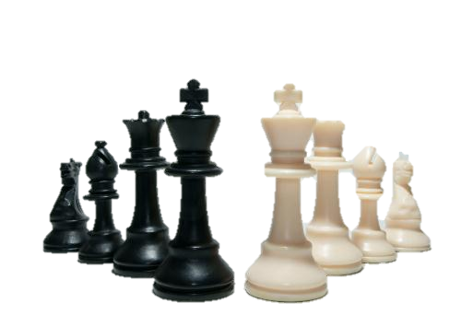
STUDYING OLIGOPOLY BEHAVIOR…
…is complicated because it’s not a single firm considering its costs and pricing in a vacuum (like perfectly competitive firms and monopolies).
The profits of a large firm depend heavily on the actions taken by other large firms.
Notes:
All image credits courtesy of Morgue File and/or FreeImages.com unless otherwise specified

Slide 8
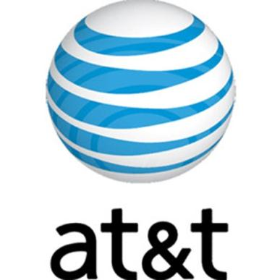
THE PREVALENCE OF OLIGOPOLY
Imperfect competition: No one firm has a monopoly, but producers can affect market prices.
Notes:
All image credits courtesy of Morgue File and/or FreeImages.com unless otherwise specified

Slide 9
MEASURING OLIGOPOLY
To get a better picture of market structure, economists often use the Herfindahl–Hirschman Index, or HHI.
The HHI for an industry is the sum of the squares of each firm’s share of market sales.
For example, if there are three firms with 60%, 25%, and 15% market share each:
HHI = 60² + 25² + 15² = 4,450

Slide 10
MEASURING OLIGOPOLY
Justice Department guidelines:
HHI of less than 1,000 indicates a strongly competitive market.
HHI of 1,000 to 1,800 indicates a somewhat competitive market.
HHI above 1,800 indicates an oligopoly.
If HHI is above 1,000, a merger that results in a significant increase in the HHI will receive special scrutiny and is likely to be disallowed.
Notes:
Notes to the Instructor: However, as recent events have shown, defining an industry can be tricky. In 2007, Whole Foods and Wild Oats, two purveyors of high-end organic foods, proposed a merger. The Justice Department disallowed it, claiming it would substantially reduce competition and defining the industry as consisting of only natural food groceries.
However, this was appealed to a federal court, which found the merger allowable since regular supermarkets now carried organic foods as well, arguing that they would provide sufficient competition after the merger. The Justice Department has appealed and, as of the time of writing, the case is still undecided.
10

Slide 11
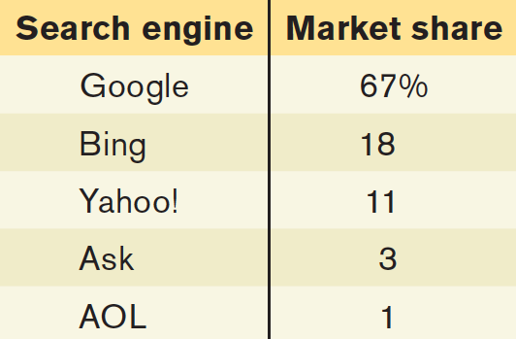
What is the HHI?
100
6,724
4,944
7,018
6,818
To Next
Active Learning

Slide 12
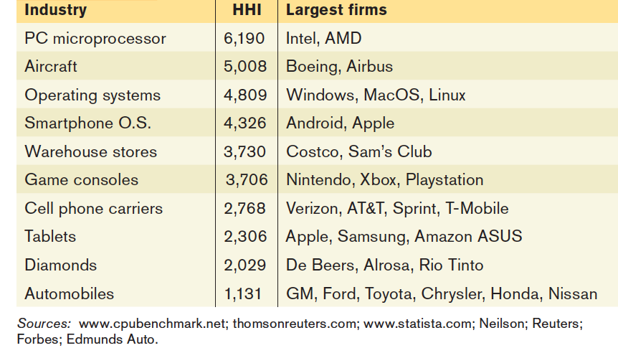
SOME OLIGOPOLISTIC INDUSTRIES

Slide 13
UNDERSTANDING OLIGOPOLY
Some of the key issues can be understood by looking at the simplest case: duopoly.
Duopoly: an oligopoly consisting of only two firms.
With only two firms in the industry, each realizes that profits would be higher if it limited its production (and kept prices higher).
Notes:
All image credits courtesy of Morgue File and/or FreeImages.com unless otherwise specified

Slide 14
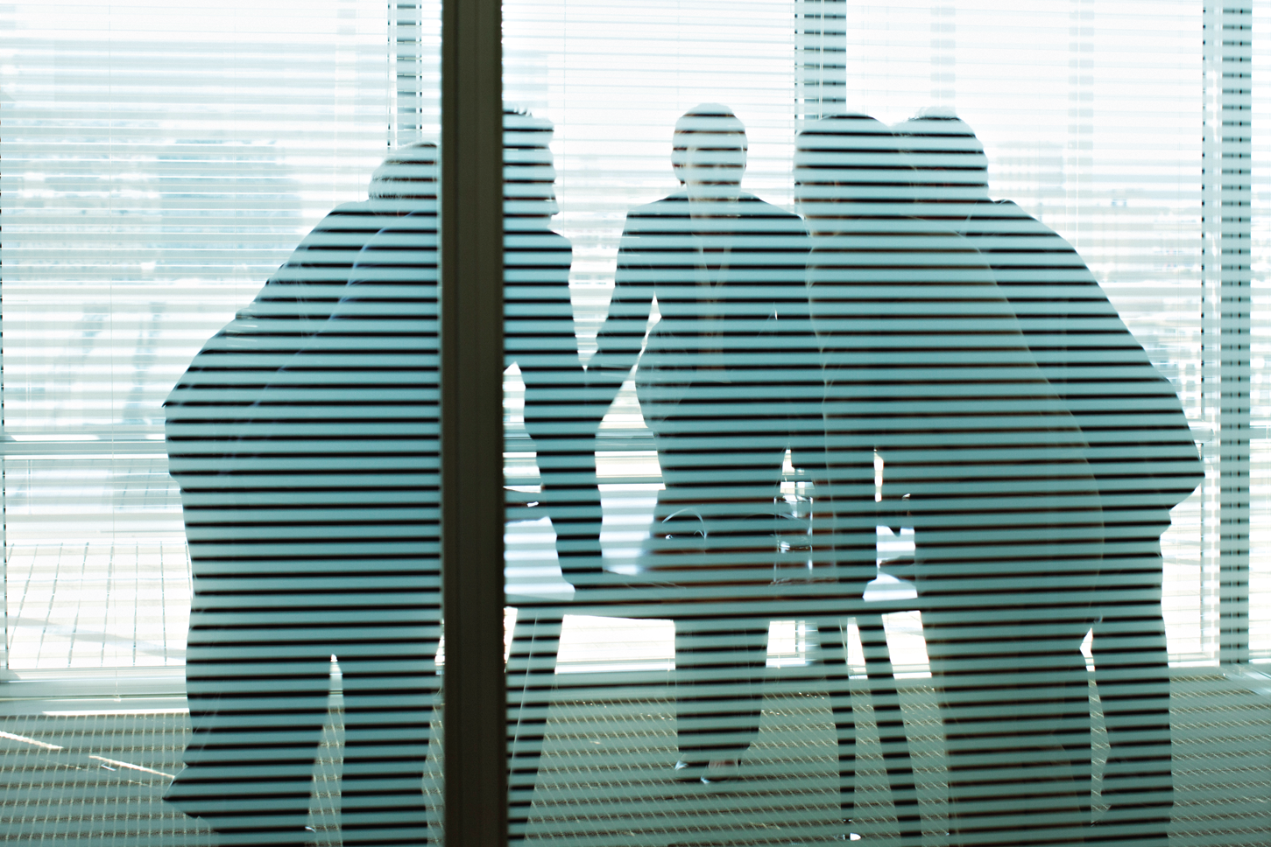
UNDERSTANDING OLIGOPOLY
Cooperation between firms may be profitable,
but it is unstable—and illegal in the United States.
Notes:
Martin Barraud/Getty Images

Slide 15
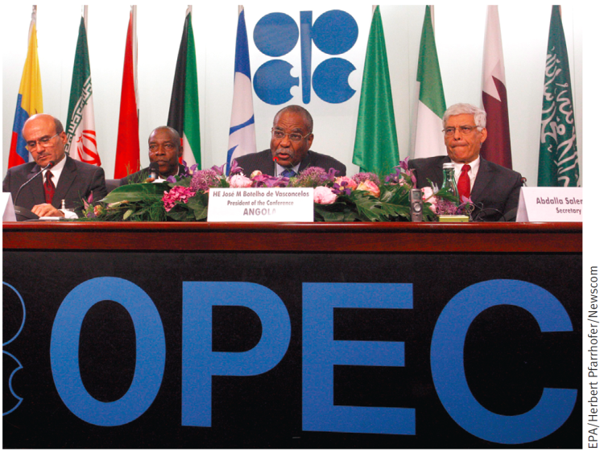
UNDERSTANDING OLIGOPOLY
Collusion: firms cooperating to raise each others’ profits.
The strongest form of collusion is a cartel, an agreement by several producers to restrict output in order to increase their joint profits.
OPEC (the Organization of Petroleum Exporting Countries) limits production for each member nation to raise oil prices and profits.
Notes:
All image credits courtesy of Morgue File and/or FreeImages.com unless otherwise specified

Slide 16
Mariachi Plaza is a sort of day-labor center for musicians, and the mariachis will quickly gather around passers-by, a horde of them jostling to get their business card into their hand.
Now, roughly 200 mariachis have joined the United Mariachi Organization of Los Angeles, a group that formed to set a minimum price in the plaza.
Notes:
To join, musicians must pay $10 a month and pledge not to charge less than $50 an hour. In return, they receive a gold-colored picture identification card, which leaders hope customers will recognize as a badge of authenticity.
Customers have come back to the plaza to complain about mediocre bands or musicians who did not show up on time…
All image credits courtesy of Morgue File and/or FreeImages.com unless otherwise specified

Slide 17
TO COOPERATE OR NOT: THAT IS THE QUESTION
Noncooperative behavior: Firms ignoring the effects of their actions on each others’ profits.
Notes:
All image credits courtesy of Morgue File and/or FreeImages.com unless otherwise specified

Slide 18
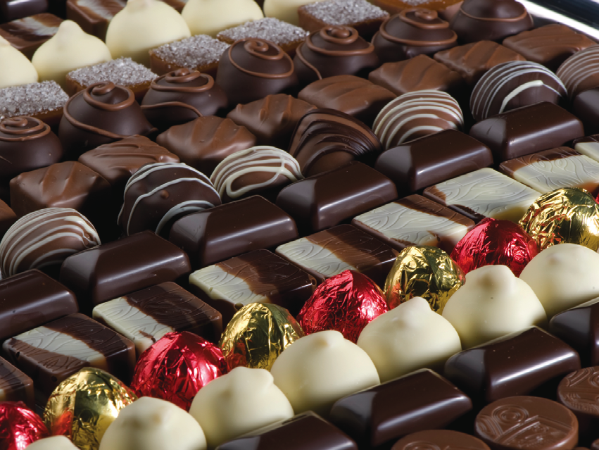
BITTER CHOCOLATE?
Are chocolate makers engaging in price-fixing?
That’s what a recent lawsuit claims.
Mars, Hershey, Nestlé and Cadbury (76% of the U.S. chocolate market) allegedly bullied grocery stores into raising their chocolate prices.
2013 saw similar cases in Canada and Germany
Notes:
Photo credit: iStockphoto/Thinkstock

Slide 19
COLLUSION OR NOT?
To maximize profit, how will firms behave?
Will each firm act in its own self-interest, even though this drives down everyone’s profits (noncooperative)?
Or
Will they engage in collusion, reaching and holding to an agreement that maximizes their combined profits?
It depends.

Slide 20
GAMES OLIGOPOLISTS PLAY
Game theory: the study of behavior in situations of interdependence; a way of predicting outcomes in strategic situations like oligopolies.
Notes:
All image credits courtesy of Morgue File and/or FreeImages.com unless otherwise specified

Slide 21
GAME THEORY IS EVERYWHERE
If you say why not bomb them tomorrow, I say why not today? If you say today at five o’clock, I say why not one o’clock?
~JOHN VON NEUMANN, game theory’s originator
Notes:
All image credits courtesy of Morgue File and/or FreeImages.com unless otherwise specified

Slide 22
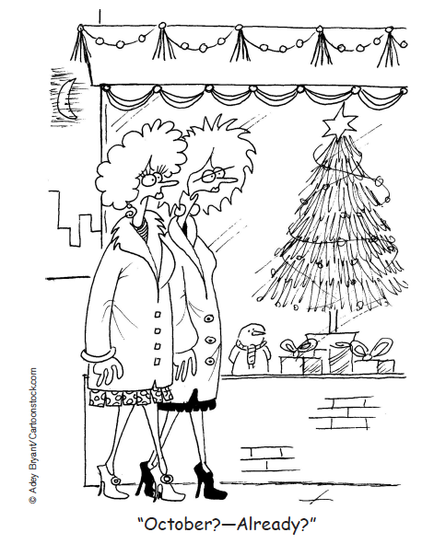
CHRISTMAS IN OCTOBER?
Notes:
© Adey Bryant/Cartoonstock.com

Slide 23
THE PRICE WARS OF CHRISTMAS
What do you get when you couple overall decline in the toy industry with new entrants (Walmart and Target)?
Intense price competition
Bankruptcy (KB Toys, FAO Schwartz, Zany Brainy)
Christmas sales come ever earlier
Notes:
All image credits courtesy of Morgue File and/or FreeImages.com unless otherwise specified

Slide 24
A PAYOFF MATRIX
Ajinomoto
Produce 30 million pounds
Produce 40 million pounds
Ajinomoto makes $180 million profit.
Ajinomoto makes $200 million profit.
Produce 30 million pounds
ADM makes $180 million profit
ADM makes $150 million profit
ADM
Ajinomoto makes $160 million profit.
Ajinomoto makes $150 million profit.
Produce 40 million pounds
ADM makes $200 million profit
ADM makes $160million profit

Slide 25
THE PRISONERS’ DILEMMA
When each firm has an incentive to cheat but both are worse off if both cheat, the situation is known as a prisoner’s dilemma.
The game based on two premises:
Each player has an incentive to choose an action that benefits itself at the other player’s expense.
When both players act in this way, both are worse off than if they had acted cooperatively.

Slide 26
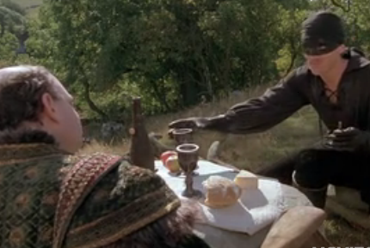
See game theory at work in this clip from The Princess Bride. (3:40 minutes)
To Next
Video
Notes:
http://criticalcommons.org/Members/gdmateer/clips/THE_PRINCESS_BRIDE_FINAL2.m4v/view

Slide 27
THE PRISONERS’ DILEMMA
Louise
Don’t confess
Confess
Louise gets 5-year sentence.
Louise gets 2-year sentence.
Don’t confess
Thelma gets 5-year sentence.
Thelma gets 20-year sentence.
Thelma
Louise gets 20-year sentence.
Louise gets 15-year sentence.
Confess
Thelma gets 2-year sentence.
Thelma gets 15-year sentence.

Slide 28
THE PRISONERS’ DILEMMA
A dominant strategy: a strategy that is a player’s best action regardless of the action taken by the other player. Depending on the payoffs, a player may or may not have a dominant strategy.
Nash equilibrium (also known as noncooperative equilibrium): the result when each player in a game chooses the action that maximizes his or her payoff given the actions of other players, ignoring the effects of his or her action on the payoffs received by those other players.

Slide 29
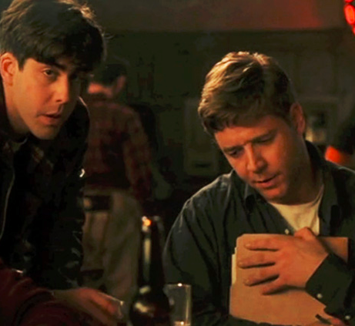
In this clip from A Beautiful Mind, we see John Nash (Russell Crowe) experience an epiphany about strategic interaction. (3 minutes)
To Next Video
Notes:
http://criticalcommons.org/Members/gdmateer/clips/A_BEAUTIFUL_MIND_FINAL2.m4v/view?portal_status_message=Changes%20saved.

Slide 30
In game theory, the strategy that has a higher payoff than any other strategy—no matter what the other player does—is also known as the:
superior strategy.
Nash equilibrium.
dominant strategy.
best possible outcome.
To Next
Active Learning

Slide 31
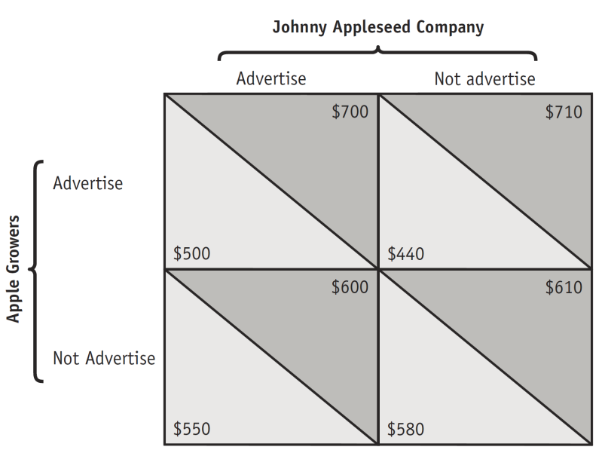
What is Apple Growers’ dominant strategy?
Advertise
Not advertise
Apple Growers does not have a dominant strategy.
To Next
Active Learning

Slide 32
Two firms are the only producers in a market. Each firm is trying to decide whether to advertise. If firm B advertises, firm A earns $2,000 in profit without advertising and $1,800 if A does advertise. (The advertising increases its costs more than its revenues.) If B does not advertise, A earns $2,200 in profit without advertising and $2,000 if A does advertise. If A advertises, B earns $3,000 in profit without advertising and $2,700 if B does advertise. If A does not advertise, B earns $2,600 without advertising and $2,400 if B does advertise.
What is firm B’s dominant strategy?
advertise
do not advertise
Firm B does not have a dominant strategy.
To Next
Active Learning

Slide 33
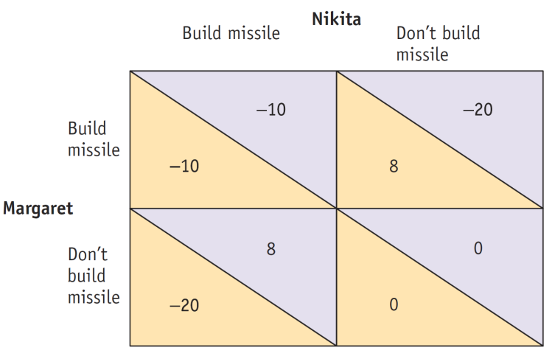
What is likely to happen? Is it the best outcome? (See next slide for explanation.)
They will both build the missile.
Neither will build the missile.
Margaret will but Nikita won’t build the missile.
Nikita will but Margaret won’t build the missile.
To Next
Active Learning

Slide 34
The joint payoff is greatest when neither builds a missile— but unlikely to occur. There is temptation to build the missile unilaterally because the individual payoff is highest when the other player does not (and you do) build it. Unless the players communicate (and enforce an arms agreement), both will act in their own interest, and each will build the missile.

Slide 35
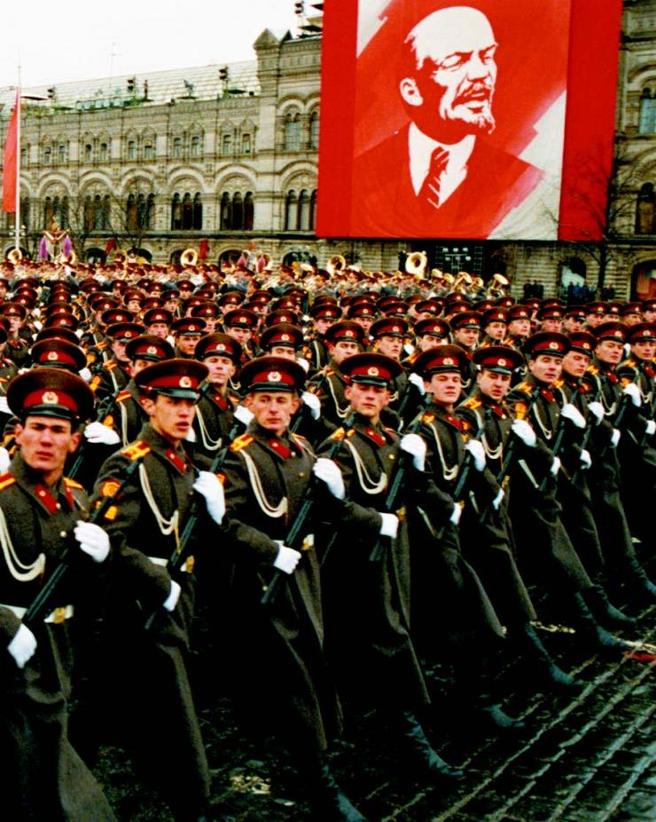
PRISONERS OF THE ARMS RACE
Why did the US and USSR spend so much money on (nonproductive) missiles and bombs during the cold war?
Why did both sides fail to reach the best joint outcome: low military spending for both countries?
Notes:
ASS/Sovfoto

Slide 36
OVERCOMING THE PRISONERS’ DILEMMA
Repeated interaction and tacit collusion
Players who don’t take their interdependence into account arrive at a Nash, or noncooperative, equilibrium.
But if a game is played repeatedly, players may engage in strategic behavior, sacrificing short-run profit to influence future behavior.
Tit for tat: a strategy of playing cooperatively at first, then doing whatever the other player did in the previous period.

Slide 37
HOW REPEATED INTERACTION CAN SUPPORT COLLUSION
Ajinomoto
Tit for tat
Always cheat
Ajinomoto makes $180 million profit each year.
Ajinomoto makes $200 million profit 1st year, $160 profit each later year.
Tit for tat
ADM makes $150 million profit 1st year, $160 million profit each later year.
ADM makes $180 million profit each year.
ADM
Ajinomoto makes $150 million profit 1st year, $160 million profit each later year.
Ajinomoto makes $160 million profit each year.
Always cheat
ADM makes $200 million profit 1st year, $160 million profit each later year.
ADM makes $160 million profit each year.

Slide 38
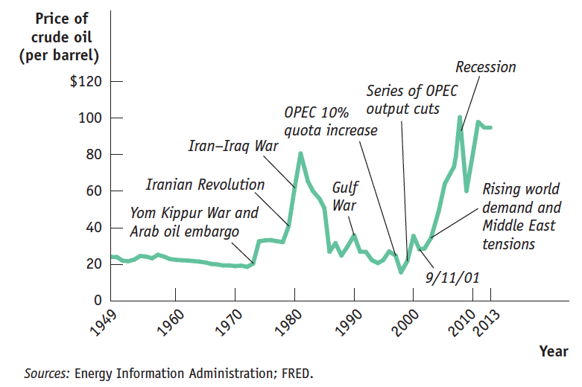
THE UPS AND DOWNS OF THE OIL CARTEL
Crude oil prices, 1949–2013
(in constant 2012 dollars)

Slide 39
OLIGOPOLY IN PRACTICE
Oligopolies operate under legal restrictions in the form of antitrust policy.
Antitrust policies: efforts undertaken by the government to prevent oligopolistic industries from becoming or behaving like monopolies.
Notes:
Bryan Smith/Zuma Press

Slide 40
THE LEGAL FRAMEWORK
Railroads created the first national markets for many goods in the later 1800’s, leading to larger firms- and cartels.
Rockefeller’s lawyers solved the cartel cheating problem by creating “trusts” controlled by a single board of trustees.
The public backlash created the first “antitrust” law: The Sherman Act of 1890
Notes:
Photo: FreeImages.com

Slide 41
OLIGOPOLY IN PRACTICE
But many succeed in achieving tacit collusion (unspoken agreements)
However, tacit collusion is limited by a number of factors, including:
less concentration.
complex products and pricing scheme.
differences in interests.
bargaining power of buyers.
Notes:
All image credits courtesy of Morgue File and/or FreeImages.com unless otherwise specified

Slide 42
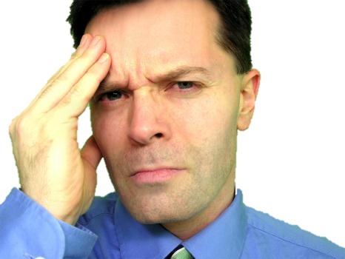
PRODUCT DIFFERENTIATION AND PRICE LEADERSHIP
When collusion breaks down and prices collapse, there is a price war.
To limit competition, oligopolists often engage in product differentiation, an attempt by a firm to convince buyers that its product is different from the products of other firms in the industry.
He’s thinking about which pain reliever “doctors recommend most”—the generic or the brand name?
Notes:
All image credits courtesy of Morgue File and/or FreeImages.com unless otherwise specified

Slide 43
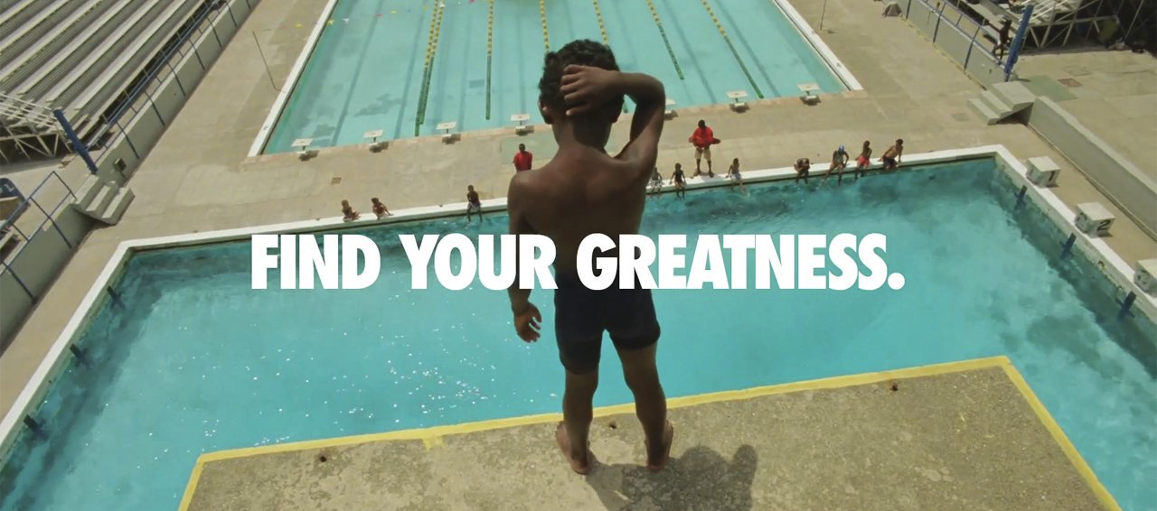
PRODUCT DIFFERENTIATION AND PRICE LEADERSHIP
Oligopolists often avoid competing directly on price, engaging in nonprice competition through advertising and other means instead.
Notes:
All image credits courtesy of Morgue File and/or FreeImages.com unless otherwise specified

Slide 44
PRODUCT DIFFERENTIATION AND PRICE LEADERSHIP
In price leadership one firm sets its price first, and other firms then follow.
GM was usually the price leader.
Notes:
All image credits courtesy of Morgue File and/or FreeImages.com unless otherwise specified

Slide 45
With a partner, explain whether you think each of the following factors will increase or decrease the likelihood that a firm will collude with other firms in an oligopoly to restrict output. (answers on next page)
The firm’s initial market share is small. (Hint: think about the price effect.)
The firm has a cost advantage over its rivals.
The firm’s customers face additional costs when they switch from one firm’s product to another firm’s product.
The firm and its rivals are currently operating at maximum production capacity, which cannot be altered in the short run.

Slide 46
With a partner, explain whether you think each of the following factors will increase or decrease the likelihood that a firm will collude with other firms in an oligopoly to restrict output.
The firm’s initial market share is small. DECREASE
The firm has a cost advantage over its rivals. DECREASE
The firm’s customers face additional costs when they switch from one firm’s product to another firm’s product. INCREASE
The firm and its rivals are currently operating at maximum production capacity, which cannot be altered in the short run. INCREASE

Slide 47
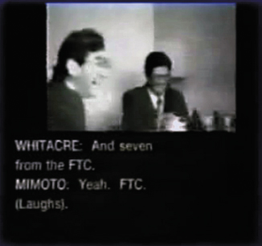
Watch the international lysine cartel discuss its conspiracy to raise prices by clicking here or below. ( 3:23 minutes)
http://www.youtube.com/watch?v=E21YYoxRs5g&feature=player_embedded
Notes:
For more, watch Matt Damon in the movie “The Informant” based on this story.
http://www.youtube.com/watch?v=E21YYoxRs5g&feature=player_embedded

Slide 48
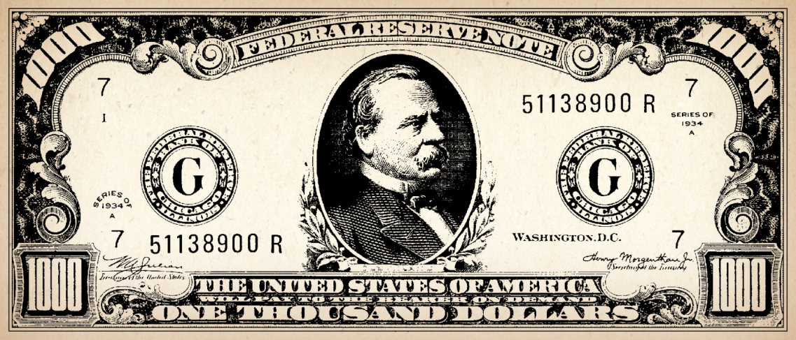
OLIGOPOLIES
Cartels may be tough to keep together, BUT oligopoly can still maintain prices (and profits) that are higher than those of competitive firms.
Notes:
All image credits courtesy of Morgue File and/or FreeImages.com unless otherwise specified

Slide 49
VIRGIN ATLANTIC BLOWS THE WHISTLE- OR BLOWS IT?
Fierce competition between the UK’s two main long-haul carriers gave way to apparent cooperation in the form of ticket price increases for both brands. Blaming the higher cost of oil, they both implemented “fuel surcharges” starting in 2004 that increased from £5 to £70- and always within days of each other.
Fearing US prosecution, Virgin blew the whistle in exchange for immunity. But no evidence was found…
Was this collusion? Why did Virgin do this?
Notes:
Image courtesy AP Photo/Alastair Grant

