Slide 1
Notes:
All image credits courtesy of Morgue File and/or FreeImages.com unless otherwise specified

Slide 2
Notes:
All image credits courtesy of Morgue File and/or FreeImages.com unless otherwise specified

Slide 3
How consumers choose to spend their income on goods and services
Why consumers make choices by maximizing utility, a measure of satisfaction from consumption
Why the principle of diminishing marginal utility applies to the consumption of most goods and services
How to use marginal analysis to find the optimal consumption bundle
What income and substitution effects are
To First
Active Learning
To Video

Slide 4
THE QUESTION: HOW DO WE CHOOSE?
How do rational consumers choose what to spend their money on?
Notes:
All image credits courtesy of Morgue File and/or FreeImages.com unless otherwise specified

Slide 5
UTILITY AND CONSUMERS
Some assumptions that will help:
All goods have utility.
Utility: value or satisfaction from consumption.
Marginal utility (MU): the change in utility from consuming an additional unit.
There is no saving. Consumers spend all income (ignore future consumption for now).
Marginal utility diminishes over time.
Diminishing marginal utility: Each additional unit of a good adds less to utility than the previous unit.
Notes:
All image credits courtesy of Morgue File and/or FreeImages.com unless otherwise specified

Slide 6
DIMINISHING MARGINAL UTILITY
Even cupcakes have diminishing marginal utility.
Notes:
All image credits courtesy of Morgue File and/or FreeImages.com unless otherwise specified

Slide 7
CASSIE’S TOTAL UTILITY AND MARGINAL UTILITY
Total utility (utils)
(a)
Cassie’s utility function
70
Quantity of clams
Total utility (utils)
Marginal utility per clam (utils)
60
Utility function
50
40
0
0
30
15
1
15
20
13
10
2
28
11
0
1
2
3
4
5
6
7
8
9
3
39
Quantity of clams
9
4
48
Marginal utility per clams (utils)
7
(
b
)
Cassie’s marginal utility curve
5
55
5
6
60
3
16
7
63
14
1
8
64
12
–1
10
9
63
8
Marginal utility curve
6
4
2
0
Quantity of clams
–2
1
2
3
4
5
6
7
8
9

Slide 8
Assume that the marginal utilities for the first three units of a good consumed are 200, 150, and 125, respectively. The total utility when two units are consumed is:
150.
200.
350.
475.
To Next
Active Learning

Slide 9
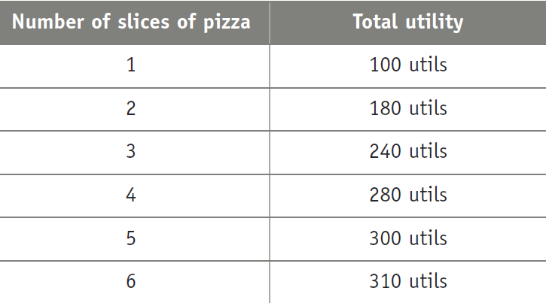
Joe’s marginal utility from consuming the fourth slice of pizza equals:
60 utils.
40 utils.
280 utils.
20 utils.
To Next
Active Learning

Slide 10
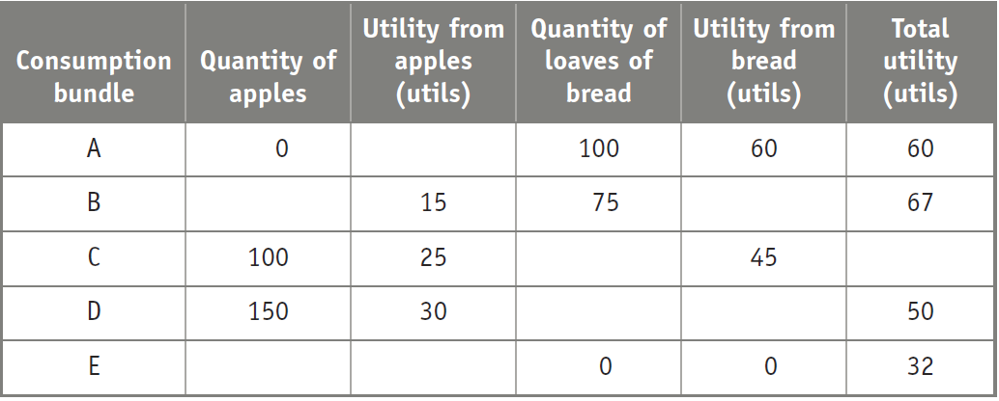
Complete the table.
To Next
Active Learning

Slide 11
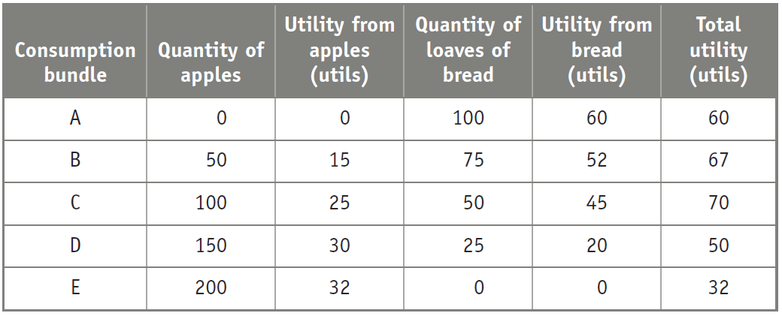
Answers for previous question
To Next
Active Learning

Slide 12
Discuss: Are people today more constrained by time or by money?
What effect does this have on consumption of cookbooks? Restaurant meals? Child care? Entertainment?
What other markets are affected?
To Next
Active Learning

Slide 13
With a partner, discuss whether going to college is worth it, considering rising tuition costs, rising student debt, and lingering unemployment.
Make at least two arguments for and two arguments against college.
To Next
Active Learning

Slide 14
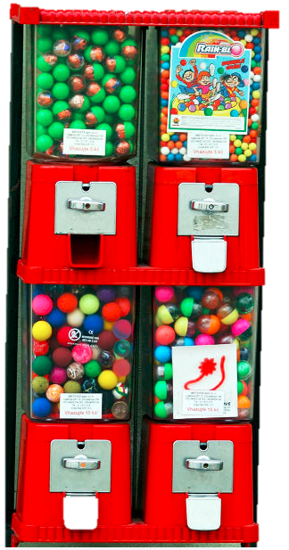
HOW TO COMPARE APPLES AND ORANGES
How many gumballs? How many ice creams?
Depends on two things:
How much you like it (utility)
How much it costs (price)
Notes:
All image credits courtesy of Morgue File and/or FreeImages.com unless otherwise specified

Slide 15
HOW TO COMPARE APPLES AND ORANGES
Since most decisions are made at the margin, we’ll need to know:
How much extra utility (MU) will you get from spending your next dollar on apples? On oranges?
We are looking to maximize the utility per dollar spent.
Notes:
All image credits courtesy of Morgue File and/or FreeImages.com unless otherwise specified

Slide 16
PREFERENCES AND OPTIMALITY
Given this family’s income, what is its optimal number of bananas and carrots?
Notes:
All image credits courtesy of Morgue File and/or FreeImages.com unless otherwise specified

Slide 17
COMPARING MU TO PRICE
The general rule: Compare the MU and the price for all goods, and then adjust your spending toward the goods that give you MORE MU per dollar
Example: If P_{GUM}= $0.25, P_{ICE CREAM}= $1.00,
MU_{GUM} = 1 , MU_{ICE CREAM}= 2,
what can you do to increase total utility?
MU_{GUM}/P_{GUM} > MU_{ICE CREAM} /P_{ICE CREAM}, so…
buy more gum: it makes you happier, dollar for dollar, than ice cream.

Slide 18
OPTIMAL CONSUMPTION BUNDLE
Or if MU_{ICE CREAM} /P_{ICE CREAM} > MU_{GUM}/P_{GUM}
Then buy more more ice cream.
The optimal consumption bundle is always where
MU_{A}/P_{A}= MU_{B}/P_{B}= ….. = MU_{Z}/P_{Z}
(subject to budget constraints) for all goods
Notes:
All image credits courtesy of Morgue File and/or FreeImages.com unless otherwise specified

Slide 19
OPTIMAL CONSUMPTION BUNDLE
Total utility (utils)
MU_{p}/P_{p}
6
At the optimal consumption bundle, the marginal utility per dollar spent on clams is equal to the marginal utility per dollar spent on potatoes.
5
4
B_{C}
3
2
C
1
B_{P}
MU_{c}/P_{c}
0
1
2
3
4
5
Quantity of clams (pounds)
10
8
6
4
2
0
Quantity of potatoes (pounds)

Slide 20
OPTIMAL CONSUMPTION BUNDLE
The optimal consumption bundle is the one that maximizes a consumer’s total utility given his or her budget constraint.
Notes:
All image credits courtesy of Morgue File and/or FreeImages.com unless otherwise specified
20

Slide 21
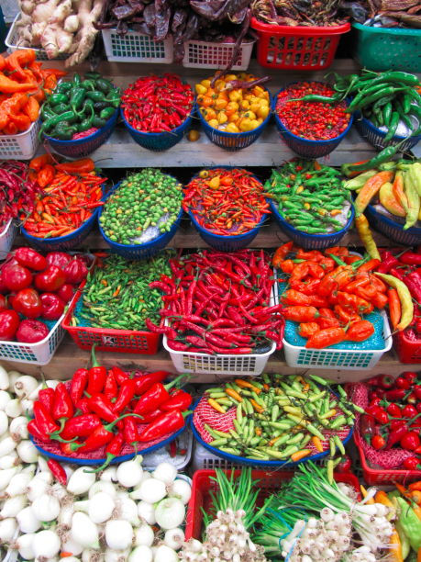
THE DEMAND CURVE
The optimal consumption rule explains why we buy less of something when its price rises (and vice versa).
Now we turn to the issue of budget: How do we maximize utility under a limited budget?
Notes:
All image credits courtesy of Morgue File and/or FreeImages.com unless otherwise specified

Slide 22
The right marginal comparison
Marginal analysis solves “how much” decisions by setting the marginal benefit of some activity equal to its marginal cost.
In consumption decisions, unlike production decisions, a budget constraint must be accounted for.
By factoring in prices, we take into account the fact that a consumer has a limited amount of money to spend.
The right answer for marginal decisions involving consumption is that the marginal utility per dollar spent on each good must be the same at the optimal consumption bundle.

Slide 23
THE BUDGET CONSTRAINT
The budget constraint shows all of the consumption bundles that a consumer can afford given his or her income and the prices.
(We’ll simplify our world to two goods, pizza and gas, for the sake of graphing.)
If income = $100, P_{gas} = $2, and P_{pizza} = $10, we can figure out our consumption possibilities.

Slide 24
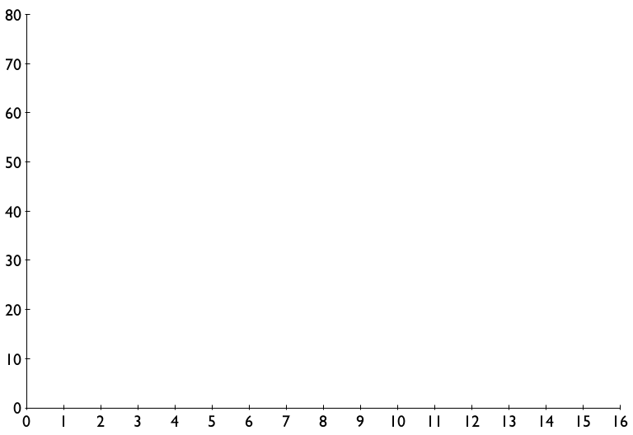
THE BUDGET CONSTRAINT
Gasoline
(gallons)
$100 in income will buy you anything along the curve
or below it…
…but not above it, sadly.
Unaffordable consumption bundles
Affordable consumption bundles that cost all of your income
Affordable consumption bundles
Pizza

Slide 25
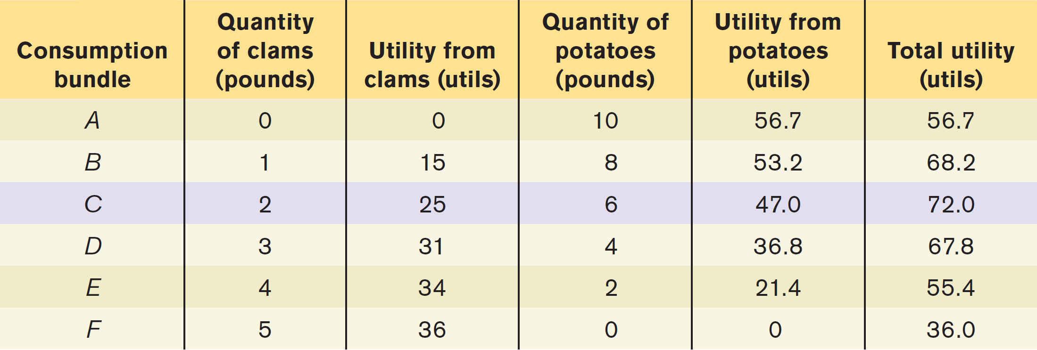
Sammy’s Budget and Total Utility
Sammy’s total utility is the sum of the utility he gets from clams and the utility he gets from potatoes.
Notes:
25

Slide 26
OPTIMAL CONSUMPTION BUNDLE
Quantity of potatoes (pounds)
(a)
Sammy’s budget line
A
The optimal consumption bundle…
10
B
8
C
6
D
4
E
2
F
BL
0
1
2
3
4
5
Quantity of clams (pounds)
(b)
Sammy’s utility function
Total utility (utils)
80
B
C
D
70
A
E
60
Utility function
50
… maximizes total utility given the budget constraint.
40
30
F
20
10
0
1
2
3
4
5
Quantity of clams (pounds)
10
8
6
4
2
0
Quantity of potatoes (pounds)

Slide 27
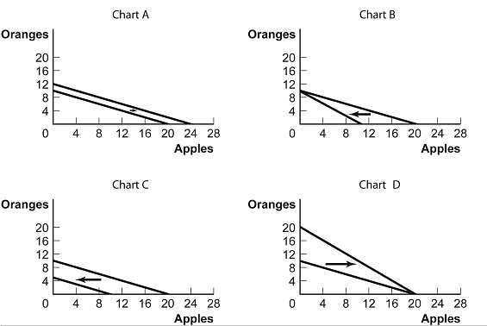
Which of the charts shows what will happen if income increases?
Chart A
Chart B
Chart C
Chart D
To Next
Active Learning

Slide 28
THE BUDGET CONSTRAINT
Gasoline
(gallons)
An increase in income shifts the
budget constraint outward.
Income = $140
Pizza

Slide 29
The Budget Constraint
If prices change, the slope of the budget constraint changes.
Back to our original $100 income. If pizzas go on sale to $5 each, what happens?
Maximum gasoline doesn’t change, but now we can afford 20 pizzas at maximum.
Gasoline
(gallons)
The slope of the budget constraint equals the amount of gas the consumer can afford if he gives up one pizza.
Slope = –2.5
Slope = –5
Pizza

Slide 30
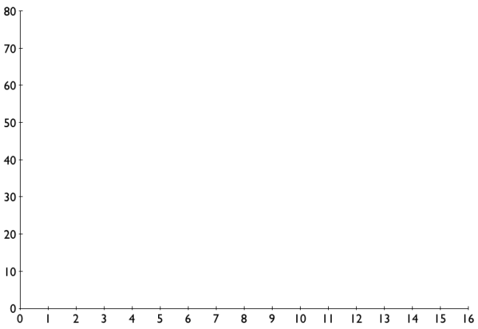
Gasoline
(gallons)
Gasoline
(gallons)
A
B
Pizza
Pizza
Which graph represents a budget constraint when income = $100, P_{gas} = $3, and P_{pizza} = $20?
A
B
To next
Try it!
To Next
Active Learning

Slide 31
Units of food
Your income is $40. The price of each unit of food is $2, and the price of each unit of clothing is $10.
Draw a graph of your budget line.
Units of clothing
To Next
Active Learning

Slide 32
Units of food
Your income rises to $50 and the prices of food and clothing remain the same.
Draw a graph of your new budget line.
Units of clothing
To Next
Active Learning

Slide 33
Units of food
Your income is $50. The price of food rises to $4 and the price of clothing remains the same.
Draw a graph of your new budget line.
Units of clothing
To Next
Active Learning

Slide 34
Psychologist Barry Schwartz takes aim at a central tenet of Western societies: freedom of choice. In this TED talk, Schwartz argues that choice has made us not freer but more paralyzed, not happier but more dissatisfied. (20 min)
Notes:
http://www.ted.com/talks/lang/en/barry_schwartz_on_the_paradox_of_choice.html

Slide 35
With a partner, discuss the idea of conspicuous consumption: Is it irrational or not?
According to Juliet Schor in The Overspent American, Americans are practitioners of conspicuous consumption. They go broke trying to keep up with people at the top of the income ladder and deny the amount of credit-card debt they have, even to themselves.
To Next
Active Learning

Slide 36
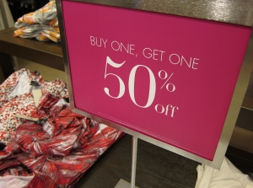
THE SUBSTITUTION EFFECT
The substitution effect (of a change in the price of a good): the change in the quantity consumed of that good as the consumer substitutes the good that has become relatively cheaper for the good that has become relatively more expensive.
Notes:
All image credits courtesy of Morgue File and/or FreeImages.com unless otherwise specified
36

Slide 37
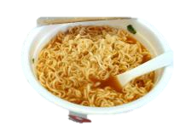
THE INCOME EFFECT
The income effect (of a change in the price of a good): the change in the quantity consumed of a good that results from a change in the consumer’s purchasing power due to the change in the price of the good.
Normal goods: Increase in price causes consumers’ purchasing power to drop and reduces consumption (and vice versa).
Inferior goods: Increase in price causes consumers’ purchasing power to drop and increases consumption (and vice versa).
Notes:
All image credits courtesy of Morgue File and/or FreeImages.com unless otherwise specified
37

Slide 38
GIFFEN GOODS
Giffen good: a hypothetical inferior good for which the income effect outweighs the substitution effect and the demand curve slopes upward.
Example: Irish potatoes, an inferior good that took up so much of an average person’s income that when potato prices rose, purchasing power dropped and they had to eat more of all inferior goods (including potatoes!)
Notes:
All image credits courtesy of Morgue File and/or FreeImages.com unless otherwise specified

Slide 39
An increase in the price of good X while holding income and the price of good Y constant will:
increase the marginal utility provided by good X.
increase the marginal utility per dollar spent on good Y.
decrease the marginal utility per dollar spent on good X.
reduce the individual’s preference for good X.
To Next
Active Learning

Slide 40
An increase in the price of good X while holding income and the price of good Y constant will:
have a positive substitution effect, leading the consumer to increase consumption of good X because of the increase in the marginal utility per dollar spent on good X.
have a negative substitution effect, leading the consumer to decrease consumption of good X because of the decrease in the marginal utility per dollar spent on good X.
cause the consumer to substitute away from good Y toward good X.
cause the consumer to purchase more units of good X because of the income effect.

