Slide 1
Notes:
All image credits courtesy of Morgue File and/or FreeImages.com unless otherwise specified

Slide 2
Notes:
All image credits courtesy of Morgue File and/or FreeImages.com unless otherwise specified

Slide 3
Why good decision making begins with accurately defining costs and benefits
The importance of implicit as well as explicit costs in decision making
The difference between accounting profit and economic profit, and why economic profit is the correct basis for decisions
Why there are three different types of economic decisions: “either–or” decisions, “how much” decisions, and decisions involving sunk costs
The principles of decision making that correspond to each type of economic decision
Why people sometimes behave irrationally in predictable ways
To First
Active Learning
To Video

Slide 4
COSTS, BENEFITS, AND PROFITS
Our decisions depend on comparing costs to benefits…
And the quality of our decisions depends on how well we understand costs and benefits.
Decisions about whether, when, and how many children are complex cost-benefit decisions.
Notes:
All image credits courtesy of Morgue File and/or FreeImages.com unless otherwise specified

Slide 5
EXPLICIT AND IMPLICIT COSTS
An explicit cost is a cost that requires an outlay of money (cost of books).
An implicit cost does not require an outlay of money; it is measured by the value, in dollar terms, of benefits that are forgone (e.g., wages forgone because of being a full-time student).
Notes:
All image credits courtesy of Morgue File and/or FreeImages.com unless otherwise specified

Slide 6
DEFINITIONS OF PROFIT: ACCOUNTING VS. ECONOMIC PROFIT
Accounting profit = revenue – explicit cost.
Economic profit:
equals revenue minus the opportunity cost of all resources used.
is usually less than accounting profit.
shows a more complete picture of costs.
helps businesses and individuals make better-informed decisions.
is the measure economists prefer.
Economic profit = revenue – explicit cost – implicit cost.

Slide 7
ZERO PROFITS
If you quit your job as a lion tamer ($45,000/year income) to open a tanning studio ($45,000/year left over after costs are paid), what is your economic profit?
We would say it’s zero: You are earning just enough to cover your costs, including your forgone lion-taming wages.
You are doing just as well in your new job as your last one.
If you hadn’t considered your implicit costs, your analysis would suffer.
Notes:
All image credits courtesy of Morgue File and/or FreeImages.com unless otherwise specified

Slide 8
The Cost of Having a Child: In The Price of Motherhood, Ann Crittenden claims the total cost for a college-educated couple to have a child is $1 million. She discusses the following items as costs of an educated woman having a child. Classify these as explicit or implicit.
Unearned Social Security credits
Forgone promotions
Salary lost by not working
Expenses for baby’s room
Loss of experience at work
Depreciation of work skills
Food and clothing for the child
Loss of pension and 401k benefits
Awards and kudos for excellence doing a paid job
Babysitting fees
Preschool expenses
Earnings from paid work contributed by an employer to a retirement account
Doctor visits, medical expenses
Costs of decorating child’s room
Lost training opportunities at work
Green = explicit, Blue = implicit
To Next
Active Learning

Slide 9
All of the following are considered implicit costs except:
paying rent on an existing building.
interest that could have been earned from the savings account if the money were not used on the existing business.
the wages the entrepreneur could have earned if he or she chose to pursue a career in corporate America.
forgone entrepreneurial income.
To Next
Active Learning

Slide 10
Sandy owns a firm with annual revenue of $1 million. Wages, rent, and other costs are $900,000. Suppose that instead of being an entrepreneur, Sandy could get a job with an annual salary of $250,000. Assume that a job would be as satisfying to Sandy as being an entrepreneur. Calculate Sandy’s economic profit.
$100,000
$50,000
$0
–$150,000
To Next
Active Learning

Slide 11
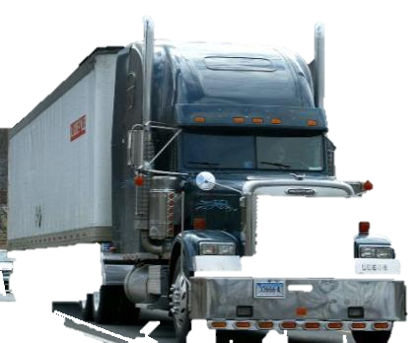
THE IMPLICIT COST OF CAPITAL
Capital is the total value of assets owned by an individual or firm—physical assets plus financial assets.
The implicit cost of capital is the opportunity cost of the use of one’s own capital:
the income earned if the capital had been employed in its next best alternative use (e.g., forgone interest income).
Notes:
All image credits courtesy of Morgue File and/or FreeImages.com unless otherwise specified

Slide 12
DECISION MAKING
There are different types of decisions:
A choice between two alternatives (“either–or”)
A more complex choice that requires us to choose at the margin (“how much?”)
Should I go to college?
Should I take an extra class?
Notes:
All image credits courtesy of Morgue File and/or FreeImages.com unless otherwise specified

Slide 13
MAKING “EITHER–OR” DECISIONS
Principle of “either–or” decision making:
when faced with an “either–or” choice between two activities (all else equal) choose the one with the positive economic profit.
In 2009, the average value of an acre of farmland in the United States overall was $2,100; in Rhode Island the average was $15,300—lots of incentive to sell.
Notes:
All image credits courtesy of Morgue File and/or FreeImages.com unless otherwise specified

Slide 14
What if, instead of just two options, there are three or more? Does the principle of “either–or” decision making still apply?
Yes. Any choice between three or more options can always be boiled down to a series of choices between two alternatives.
Notes:
All image credits courtesy of Morgue File and/or FreeImages.com unless otherwise specified

Slide 15
MAKING “HOW MUCH” DECISIONS: THE ROLE OF MARGINAL ANALYSIS
To make good “how much?” decisions requires weighing the additional costs and benefits of each increase.
Marginal cost: the additional cost incurred by producing one more unit of that good or service.
What does it cost to make one more doll?
Notes:
All image credits courtesy of Morgue File and/or FreeImages.com unless otherwise specified

Slide 16
THE SHAPE OF MARGINAL COST
The marginal cost curve shows how the cost of producing one more unit depends on the quantity that has already been produced.
Each product has a unique marginal cost. Some basic shapes:
Increasing marginal cost: Each additional unit costs more to produce than the previous one.
Constant marginal cost: Each additional unit costs the same to produce as the previous one.
Decreasing marginal cost: Each additional unit costs less to produce than the previous one.
Marginal benefit: The additional benefit derived from producing one more unit of that good or service.

Slide 17
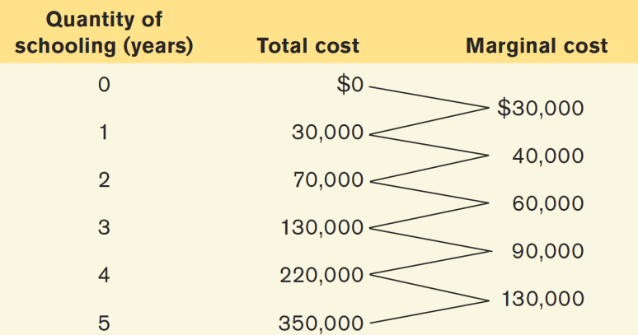
MARGINAL COST OF ALEX’S SCHOOLING
Marginal cost
$300,000
200,000
Marginal cost curve, MC
100,000
0
1
2
3
4
5
Quantity of schooling (years)

Slide 18
Total Cost Versus Marginal Cost
It can be easy to conclude that marginal
cost and total cost must always move in
the same direction.
If marginal cost of producing the first widget is $5, the second $4, and the third $3, total cost rises as marginal cost falls.

Slide 19
MARGINAL BENEFIT
Marginal benefit: the additional benefit derived from producing one more unit of a good or service.
Notes:
All image credits courtesy of Morgue File and/or FreeImages.com unless otherwise specified

Slide 20
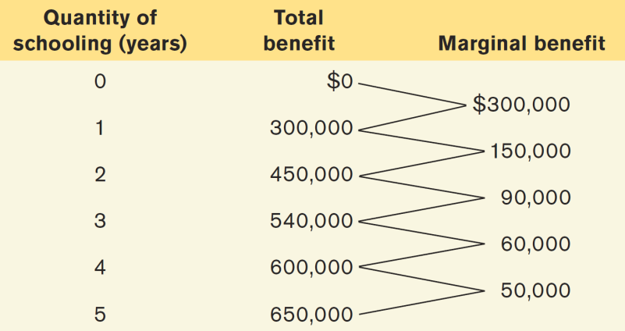
MARGINAL BENEFIT OF ALEX’S SCHOOLING
Marginal cost
$300,000
200,000
100,000
Marginal benefit curve, MB
0
1
2
3
4
5
Quantity of schooling (years)

Slide 21
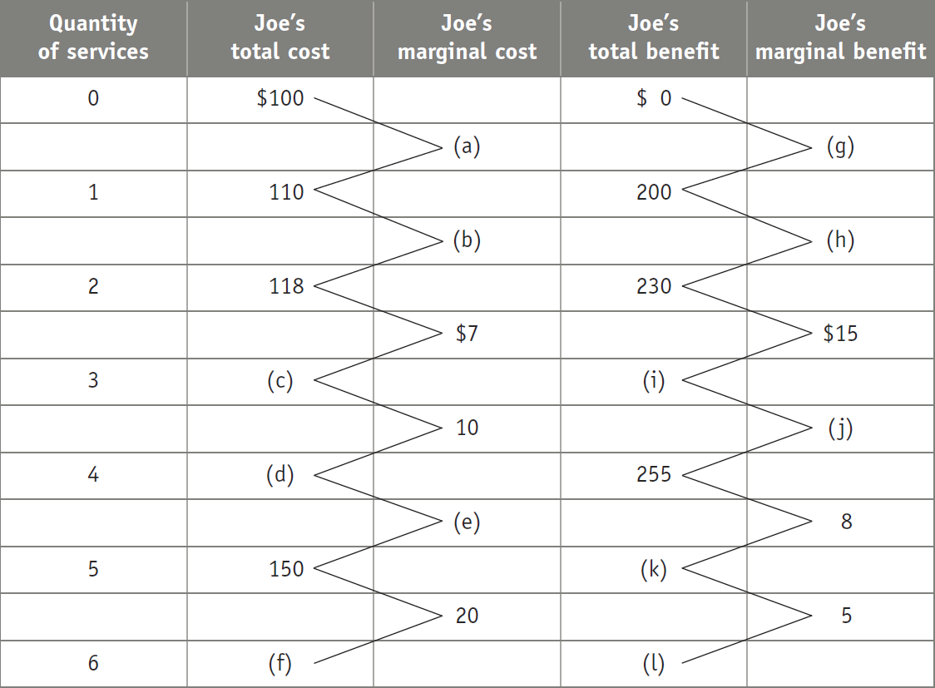
Fill in the missing cells (a) through (l)
To Next
Active Learning

Slide 22
MARGINAL ANALYSIS
Profit-maximizing principle of marginal analysis:
For a profit-maximizing “how much” decision, the optimal quantity is the largest quantity at which the marginal benefit is greater than or equal to marginal cost.
Notes:
All image credits courtesy of Morgue File and/or FreeImages.com unless otherwise specified

Slide 23
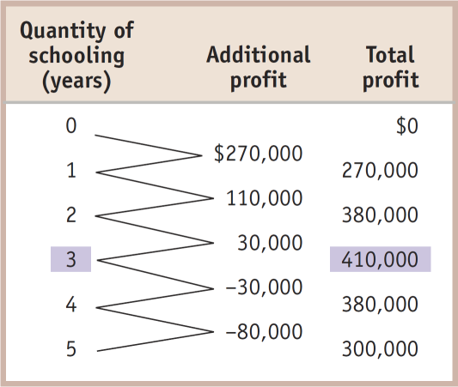
MARGINAL ANALYSIS
Marginal cost, Marginal benefit
$300,000
200,000
MC
Optimal point
100,000
MB
0
1
2
0
3
4
5
Quantity of schooling (years)

Slide 24
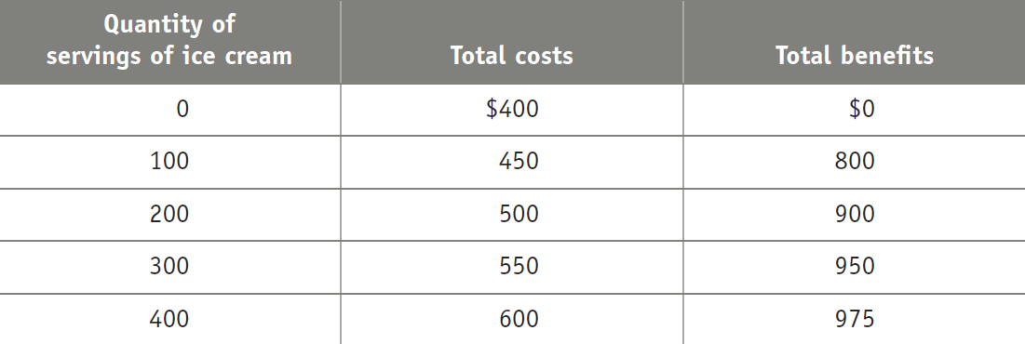
What is the optimal number of servings of ice cream to produce?
400
300
200
100
To Next
Active Learning

Slide 25
Estimate how long you plan to spend studying for the next economics exam. Write your estimate in your notes in a visible place.
Now share your number with a partner and discuss why your estimates may be different.
To Next
Active Learning

Slide 26
Aren’t we trying to maximize the difference between benefits and costs?
Yes.
What we are doing here is setting marginal (not total) benefit and cost equal to each other.

Slide 27
Joey has resolved to lose weight. His doctors have educated him about the dangers of his current weight. He thinks that if he stops eating ice cream for breakfast and forgoes seconds at mealtimes, he should be able to shed the fat.
He plans to start his diet plan tomorrow. Behavioral economics suggests that he will have trouble losing this weight because of:
aversion to loss.
bias toward maintaining the status quo.
unrealistic expectations about future behavior.
All of the answers are correct.
Answers (b) and (c) are both correct.
To Next
Active Learning

Slide 28
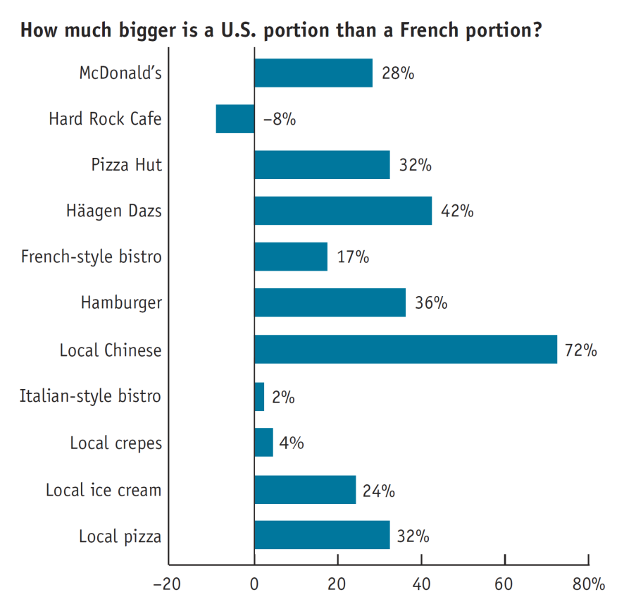
THE FRENCH PARADOX
Although lower in fat, portion sizes (and waistlines) are larger in the United States than France.
Why? Food in the United States is cheaper to produce.
The marginal cost of larger portions is small compared to the higher price you can charge…

Slide 29
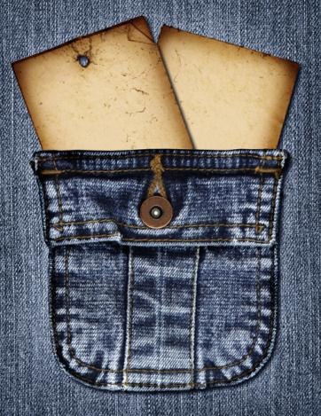
SUNK COSTS
Sunk cost: a cost that has already been incurred and is not recoverable.
A sunk cost should be ignored in decisions about future actions (but this is sometimes hard to do).
If you lose your concert tickets, the $80 you’ve already spent on them is irrelevant to the decision whether to replace them—it is a sunk cost.
Notes:
All image credits courtesy of Morgue File and/or FreeImages.com unless otherwise specified

Slide 30
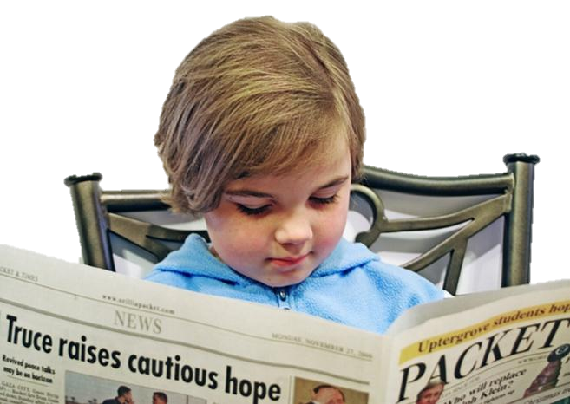
BEHAVIORAL ECONOMICS
We assume humans are mostly rational…
A rational decision maker always chooses the available option that leads to the outcome he or she most prefers.
Are there limits to human rationality?
Notes:
All image credits courtesy of Morgue File and/or FreeImages.com unless otherwise specified

Slide 31
RATIONAL, BUT HUMAN, TOO
Three reasons people might rationally choose a worse payoff:
Concerns about fairness: Providing for others sometimes trumps self-interest.
Bounded rationality—“good enough”: Making a choice that is close to (but not exactly) the highest possible profit MAY MAKE SENSE because the effort of finding the best payoff is too costly.
Risk aversion: Willingness to sacrifice some economic payoff in order to avoid a potential loss IS FAIRLY COMMON.

Slide 32
IRRATIONALITY: AN ECONOMIST’S VIEW
An irrational decision maker chooses an option that leaves him or her worse off than choosing another available option.
Notes:
All image credits courtesy of Morgue File and/or FreeImages.com unless otherwise specified

Slide 33
IRRATIONALITY: AN ECONOMIST’S VIEW
There are known (and predictable) holes in our rationality that stem from six established decision-making mistakes.
Notes:
All image credits courtesy of Morgue File and/or FreeImages.com unless otherwise specified

Slide 34
Are we in control of our own decisions? Behavioral economist Dan Ariely, the author of Predictably Irrational, uses fun (and sometimes shocking) research findings in this TED talk to show how we're not as rational as we think when we make decisions. (18 minutes)
Notes:
http://www.ted.com/talks/lang/en/dan_ariely_asks_are_we_in_control_of_our_own_decisions.html

Slide 35
IRRATIONALITY: AN ECONOMIST’S VIEW
1. Misperceptions of opportunity costs:
If we don’t understand all of the costs, we cannot make a rational choice.
Notes:
All image credits courtesy of Morgue File and/or FreeImages.com unless otherwise specified

Slide 36
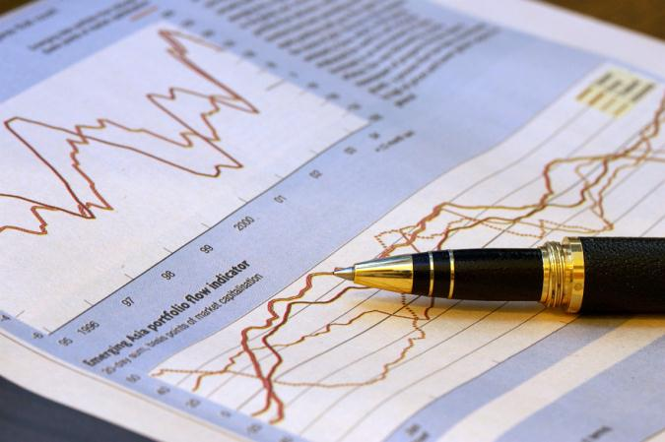
IRRATIONALITY: AN ECONOMIST’S VIEW
2. Overconfidence:
Nonprofessional investors who engage in speculative investing have significantly worse results than professional brokers because of their misguided faith in their ability to spot a winner.
Notes:
All image credits courtesy of Morgue File and/or FreeImages.com unless otherwise specified

Slide 37
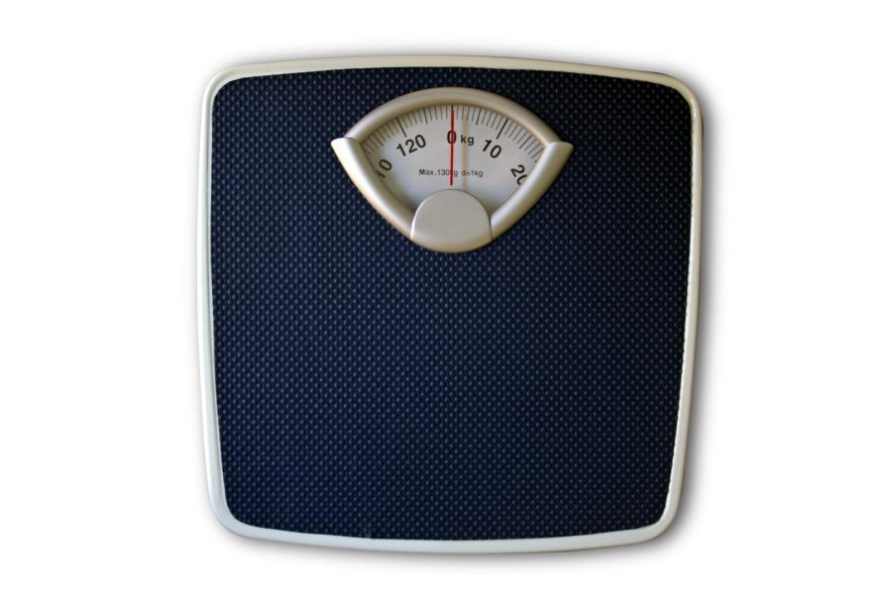
IRRATIONALITY: AN ECONOMIST’S VIEW
3. Unrealistic expectations about future behavior:
Most of us are overly optimistic about our future behavior and level of discipline.
Notes:
All image credits courtesy of Morgue File and/or FreeImages.com unless otherwise specified

Slide 38
IRRATIONALITY: AN ECONOMIST’S VIEW
4. Counting dollars unequally
Mental accounting: the habit of mentally assigning dollars to different accounts so that some dollars are worth more than others.
(E.g., spending more with credit cards than cash)
Notes:
All image credits courtesy of Morgue File and/or FreeImages.com unless otherwise specified

Slide 39
Remember those concert tickets?
If you lost your $80 concert tickets, would you replace them?
Yes
No
To Next
Active Learning
Notes:
All image credits courtesy of Morgue File and/or FreeImages.com unless otherwise specified

Slide 40
Now consider an alternative:
If you lost $80 cash that you were going to use for the concert tickets, would you still attend the concert?
Yes
No
Was your answer different from the first scenario? Then you have been using different mental accounts.
To Next
Active Learning
Notes:
All image credits courtesy of Morgue File and/or FreeImages.com unless otherwise specified

Slide 41
IRRATIONALITY: AN ECONOMIST’S VIEW
5. Loss aversion: an oversensitivity to loss that leads to unwillingness to recognize a loss and move on.
Notes:
All image credits courtesy of Morgue File and/or FreeImages.com unless otherwise specified

Slide 42
Which would you choose?
a 61% chance to win $520,000 or
a 63% chance to win $500,000?
Now which would you choose?
a 98% chance to win $520,000 or
A 100% chance to win $500,000
Most people choose (a) in the first problem and (b) in the second… and prove themselves to be loss-averse (and irrational!), since both problems offer the same probability change in gain (or loss), and yet they chose differently.
(This is called the Allais problem after Nobel Prize–winning Maurice Allais, who asked the question in 1952 and proved that even economists were susceptible to irrationality.)

Slide 43
IRRATIONALITY: AN ECONOMIST’S VIEW
6. Status quo bias: the tendency to avoid making a decision altogether.
In Austria, almost 100% choose voluntary organ donation. In neighboring (and culturally similar) Germany: 12%. Sweden: 86%. Denmark: 4%.
The common thread: in Sweden and Austria the form contains an “opt-out” box for donation. In Germany and Denmark you must check a box to opt in to the program.

