Slide 1
Notes:
All image credits courtesy of Morgue File and/or FreeImages.com unless otherwise specified

Slide 2
Notes:
All image credits courtesy of Morgue File and/or FreeImages.com unless otherwise specified

Slide 3
The meaning of price controls and quantity controls, two kinds of government intervention in markets
How price and quantity controls create problems and can make a market inefficient
What deadweight loss is
Why the predictable side effects of intervention in markets often lead economists to be skeptical of its usefulness
Who benefits and who loses from market interventions, and why they are used despite their well-known problems
To First
Active Learning
To Video
Copyright 2015 Worth Publishers

Slide 4

INTERFERENCE IN MARKETS HAS CONSEQUENCES
New York City’s laws create shortages of licensed taxicabs and housing: a good idea?
Notes:
Image courtesy of ©UpperCut Images/Alamy

Slide 5
INTERFERENCE IN MARKETS HAS CONSEQUENCES
Distorted price signals cause resources to be misallocated.
If prices are distorted, they cannot give good information to buyers and sellers.
Notes:
All image credits courtesy of Morgue File and/or FreeImages.com unless otherwise specified

Slide 6
PRICE CONTROLS
Price controls: legal restrictions on how high or low a market price may go. There are two main types:
  Price ceiling: a maximum price sellers are allowed to charge for a good or service (usually set BELOW equilibrium).
  Price floor: a minimum price buyers are required to pay for a good or service (usually set ABOVE equilibrium).

Slide 7
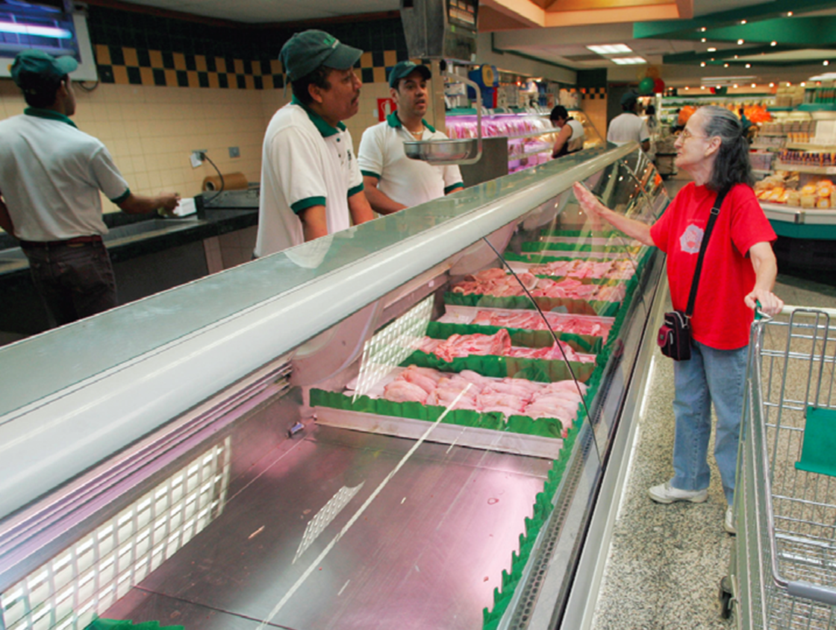
PRICE CEILINGS
Venezuela’s food shortages: Price ceilings may be well intentioned but are usually not a good idea.
Notes:
All image credits courtesy of Morgue File and/or FreeImages.com unless otherwise specified

Slide 8
HOW PRICE CEILINGS CAUSE INEFFICIENCY
Price ceilings cause predictable side effects:
Inefficiently low quantity
Inefficient allocation to customers
Wasted resources
Inefficiently low quality
Black markets

Slide 9
THE MARKET FOR APARTMENTS
Monthly rent (per apartment)
Quantity of apartments
S
Monthly rent (per apartment)
(millions)
$1,400
Quantity demanded
Quantity supplied
1,300
1,200
$1,400
1.6
2.4
1,100
1,300
1.7
2.3
E
1,200
1.8
2.2
1,000
1,100
1.9
2.1
900
1,000
2.0
2.0
800
900
2.1
1.9
700
800
2.2
1.8
700
2.3
1.7
600
D
600
2.4
1.6
0
1.6
1.7
1.8
1.9
2.0
2.1
2.2
2.3
2.4
Quantity of apartments (millions)

Slide 10
THE EFFECTS OF A PRICE CEILING
Monthly rent (per apartment)
$1,400
S
1,200
E
1,000
Price ceiling
A
B
800
Housing shortage of 400,000 apartments caused by price ceiling
600
D
0
1.6
1.8
2.0
2.2
2.4
Quantity of apartments (millions)

Slide 11
BINDING, OR EFFECTIVE, PRICE CEILINGS
If a price ceiling is set above equilibrium, it will have no effect (called nonbinding).
Monthly rent (per apartment)
$1,400
S
Nonbinding
price ceiling
1,200
Only a price ceiling that forces price below equilibrium will have any effect (called binding or effective).
E
1,000
A
B
800
Binding, or effective, price ceiling
600
D
0
1.6
1.8
2.0
2.2
2.4
Quantity of apartments (millions)

Slide 12
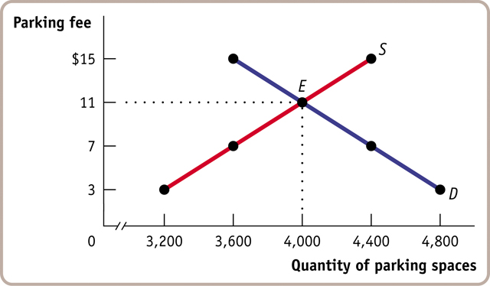
Check Your Understanding 5-1
Question 1
Homeowners near Middletown University’s stadium used to rent parking spaces in their driveways to fans at a going rate of $11.
A new town ordinance now sets a maximum parking fee of $7. Use the accompanying supply and demand diagram to answer the following questions.
To Next
Active Learning

Slide 13
1a) Given the new price of $7 some homeowners now think it’s not worth the hassle to rent out spaces. This causes:
Given the new price of $7, some homeowners now think it’s not worth the hassle to rent out spaces. This causes:
supply to shift left.
quantity to decrease along the supply curve.
To Next
Active Learning
Notes:
The decrease in price from $11 to $7 causes a decrease in quantity supplied of 400, from 4,000 to 3,600.

Slide 14
1a) Given the new price of $7 some homeowners now think it’s not worth the hassle to rent out spaces. This causes:
Some fans who used to carpool drive to the game alone because of the lower price of parking. This causes:
demand to shift right.
quantity demanded to increase along the demand curve.
To Next
Active Learning

Slide 15
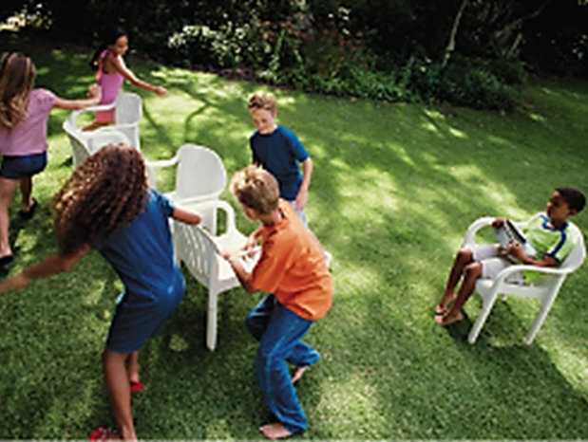
INEFFICIENTLY LOW QUANTITY
When prices are held below the market price, shortages are created.
  The lower the controlled price relative to the market equilibrium price, the larger the shortage.
Notes:
All image credits courtesy of Morgue File and/or FreeImages.com unless otherwise specified

Slide 16

PRICE CONTROLS CAUSE LOSSES
Deadweight loss: the loss in total surplus that occurs whenever an action or a policy reduces the quantity transacted below the efficient market equilibrium quantity.
Notes:
All image credits courtesy of Morgue File and/or FreeImages.com unless otherwise specified

Slide 17
1a) Given the new price of $7 some homeowners now think it’s not worth the hassle to rent out spaces. This causes:
If the government imposed a maximum parking fee of $7, you would expect there to be a(n) ________ of parking spaces.
shortage
surplus
equilibrium number of
To Next
Active Learning

Slide 18
A PRICE CEILING CAUSES INEFFICIENTLY LOW QUANTITY
Monthly rent
(per apartment)
Deadweight loss from fall in number of apartments rented
$1,400
S
1,200
E
1,000
Price ceiling
800
600
D
0
1.6
1.8
2.0
2.2
2.4
Quantity of apartments (millions)
Quantity supplied with rent control
Quantity supplied without rent control

Slide 19
1a) Given the new price of $7 some homeowners now think it’s not worth the hassle to rent out spaces. This causes:
Find the amount of deadweight loss caused by a price ceiling of $7.
$1,600
$4,400
$25,200
$60,000
To Next
Active Learning
Notes:
Deadweight loss is the area between the demand and supply curves from the quantity of 3,600 to the quantity of 4,000. Deadweight loss = 0.5 x $8 x 400 = $1,600.

Slide 20
WINNERS AND LOSERS FROM RENT CONTROL
Monthly rent (per apartment)
(a) Before rent control
Monthly rent
(per apartment)
(b) After rent control
Consumer surplus
Consumer surplus
S
Consumer surplus transferred from producers
S
$1,400
$1,400
1,200
1,200
Price ceiling
E
E
1,000
1,000
800
800
600
Producer surplus
600
Producer surplus
Deadweight loss
D
D
0
1.6
1.8
2.0
2.2
2.4
0
1.6
1.8
2.0
2.2
2.4
Quantity of apartments (millions)
Quantity of apartments (millions)
Producers lose; some lucky renters gain; and some unlucky but willing renters don’t get a place at all.

Slide 21
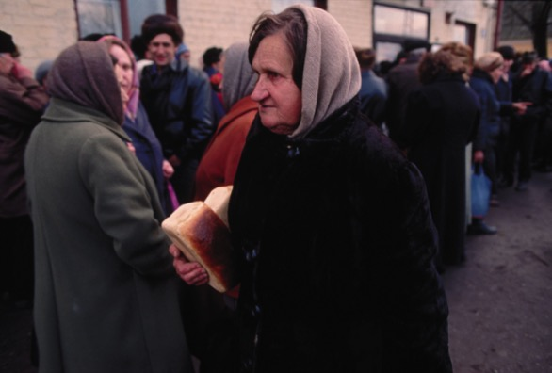
INEFFICIENT ALLOCATION TO CUSTOMERS
Price controls distort signals that would help the goods get allocated their highest-valued uses.
  Consumers who value a good most don’t necessarily get it.
  So producers have no incentive to supply the good to the “right” people first.
As a result, goods are misallocated.
Just another day in a USSR bread line.
Average time in line for a Soviet woman?
2 hours every day, 7 days a week.
Universal price controls caused widespread and persistent shortages in the USSR.
Notes:
All image credits courtesy of Morgue File and/or FreeImages.com unless otherwise specified

Slide 22
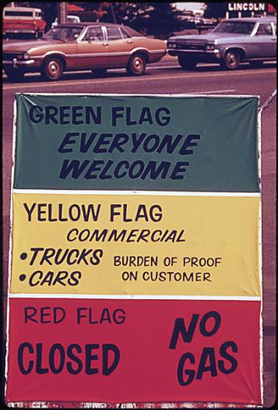
WASTED RESOURCES
Price controls that create shortages lead to bribery and wasteful lines.
          Shortages: not all buyers will be able to purchase the good.
          Normally, buyers would compete with each other by offering a higher price.
          If price is not allowed to rise, buyers must compete in other ways (waiting in line, illegal bribes and favors).
Notes:
All image credits courtesy of Morgue File and/or FreeImages.com unless otherwise specified

Slide 23
INEFFICIENTLY LOW QUALITY
At the controlled price, sellers have more customers than goods.
  In a free market, this would be an opportunity to profit by raising prices.
  But when prices are controlled, sellers cannot.
  Sellers respond to this problem in two ways:
    Reduce quality
    Reduce service
When did full-service gas stations go away? During the price ceilings in the 1970s.
Notes:
Instructor Notes:

Slide 24
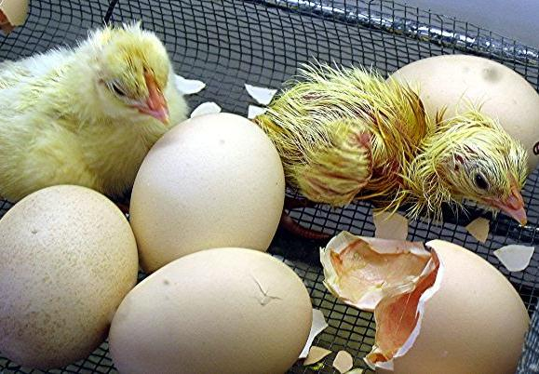

Why do you think farmers killed a million baby chickens in 1973?
Does it matter that chicken prices were subject to a price ceiling but their feed was not? Click here or on the picture for look at the far-reaching implications of price controls. (First 1:40 min of the clip)
To next Video
Notes:
http://www.youtube.com/watch?v=IFbAwzU6G7s&NR=1

Slide 25

BLACK MARKETS
A black market is a market in which goods or services are bought and sold illegally—either because they are prohibited or because the equilibrium price is illegal.

Slide 26
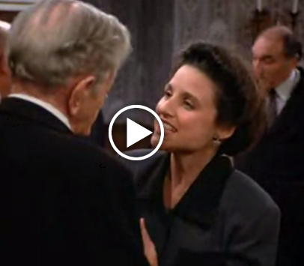
In this clip from Seinfeld, we see how alternate rationing mechanisms come into play with a rent ceiling. (1:20 minutes)
Notes:
http://criticalcommons.org/Members/gdmateer/clips/spongebob_squarepants_banned_in_bikini_bottom_final.m4v/view?searchterm=banned%20in%20bikini%20bottom

Slide 27
1a) Given the new price of $7 some homeowners now think it’s not worth the hassle to rent out spaces. This causes:
Some fans arrive several hours early in order to find parking after the imposition of a $7 price ceiling. What would you call this outcome?
shortage
wasted resources
inefficiently low quality
black markets
To Next
Active Learning

Slide 28
1a) Given the new price of $7 some homeowners now think it’s not worth the hassle to rent out spaces. This causes:
Friends of homeowners near the stadium regularly attend games, even if they aren’t big fans. But some serious fans have given up because of the parking situation caused by the imposition of a $7 price ceiling. What would you call this?
inefficient allocation of goods
wasted resources
inefficiently low quality
black markets
To Next
Active Learning

Slide 29
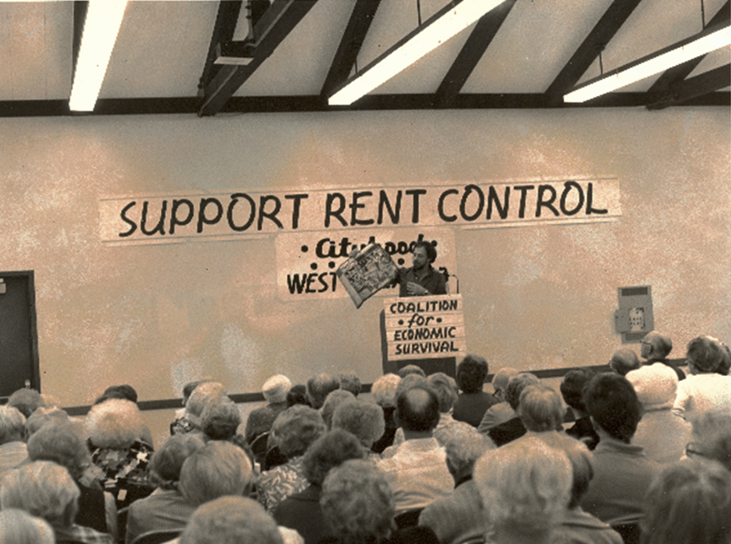
SO WHY ARE THERE PRICE CEILINGS?
They do benefit some people (who are typically better organized and more vocal than those who are harmed by them).
If the price ceiling is longstanding, buyers may not have a realistic idea of what would happen without it.
Government officials often do not understand supply and demand analysis.
Notes:
All image credits courtesy of Morgue File and/or FreeImages.com unless otherwise specified

Slide 30
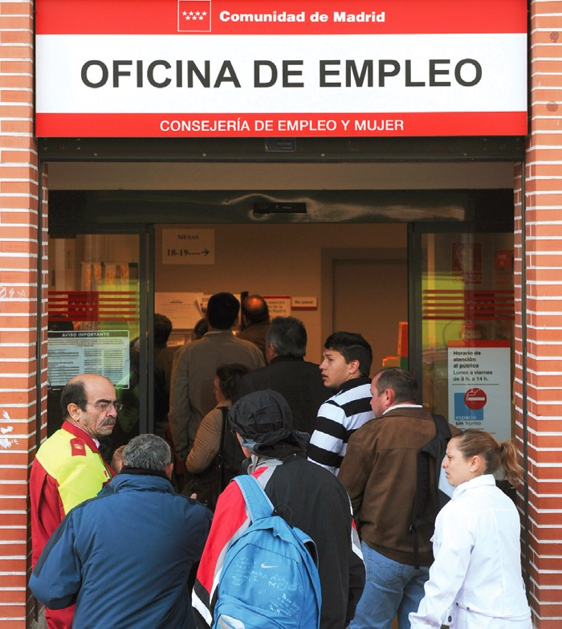
PRICE FLOORS
Sometimes governments intervene to push market prices up instead of down.
The generous minimum wage in many European countries has contributed to a high rate of unemployment and the flourishing of an illegal labor market.
Notes:
All image credits courtesy of Morgue File and/or FreeImages.com unless otherwise specified

Slide 31
THE MARKET FOR BUTTER IN THE ABSENCE OF GOVERNMENT CONTROLS
Price of butter
(per pound)
S
$1.40
Quantity of butter
1.30
(millions of pounds)
Price of butter
Quantity demanded
Quantity supplied
1.20
(per pound)
1.10
E
$1.40
8.0
14.0
1.00
$
1.30
8.5
13.0
$
1.20
9.0
12.0
0.90
$
1.10
9.5
11.0
0.80
$
1.00
10.0
10.0
$
0.90
10.5
9.0
0.70
$
0.80
11.0
8.0
0.60
$
0.70
11.5
7.0
D
$
0.60
12.0
6.0
0
6
7
8
9
10
11
12
13
14
Quantity of butter (millions of pounds)

Slide 32
BINDING, OR EFFECTIVE, PRICE FLOORS
If a price floor is set below equilibrium, it will have no effect (called nonbinding).
Price of butter
(per pound)
$1.40
S
Binding, or effective, price floor
1.20
A
B
Only a price floor that forces price above equilibrium will have any effect (binding, or effective).
E
1.00
0.80
Nonbinding price floor
0.60
D
0
6
8
9
10
12
14
Quantity of butter (millions of pounds)

Slide 33
HOW A PRICE FLOOR CAUSES INEFFICIENCY
Price floors cause predictable side effects:
Deadweight loss from inefficiently low quantity
Inefficient allocation of sales among sellers
Wasted resources
Inefficiently high quality
Temptation to break the law by selling below the legal price

Slide 34
THE EFFECTS OF A PRICE FLOOR
Price of butter (per pound)
$1.40
Butter surplus of 3 million pounds caused by price floor
S
1.20
A
B
E
Price floor
1.00
0.80
0.60
D
0
6
8
9
10
12
14
Quantity of butter (millions of pounds)

Slide 35
A PRICE FLOOR CAUSES INEFFICIENTLY LOW QUANTITY
Price of butter (per pound)
$1.40
S
1.20
Deadweight loss
E
Price floor
1.00
0.80
0.60
D
0
6
8
9
10
12
14
Quantity of butter (millions of pounds)
Quantity demanded with price floor
Quantity demanded without price floor

Slide 36

INEFFICIENT ALLOCATION OF SALES AMONG SELLERS
Price floors misallocate sales by:
Allowing high-cost firms to operate.
Preventing low-cost firms from entering the industry.
Price floors and regulation prevented Southwest (and 79 other firms) from entering the national market
Notes:
All image credits courtesy of Morgue File and/or FreeImages.com unless otherwise specified

Slide 37
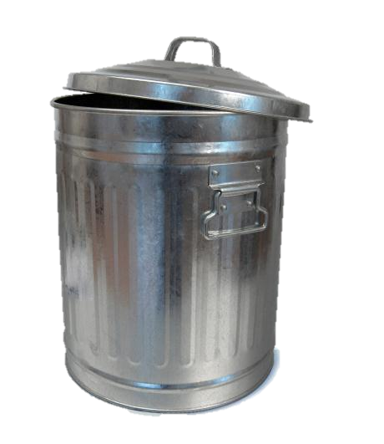
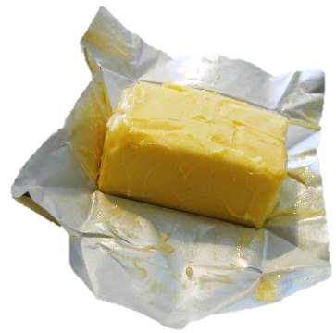
WASTED RESOURCES
Price floors encourage waste.
To deal with the surplus generated by agricultural price floors, the U.S. government sometimes buys back the excess and donates or destroys it.
Notes:
All image credits courtesy of Morgue File and/or FreeImages.com unless otherwise specified

Slide 38
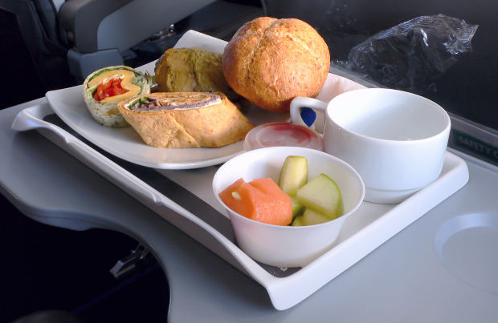
INEFFICIENTLY HIGH QUALITY
Higher quality raises costs and reduces sellers’ profit.
Buyers get higher quality but would prefer a lower price.
Price floors encourage sellers to waste resources:
higher quality than buyers are willing to pay for
Most flyers prefer a lower ticket price (with no food included)
Notes:
All image credits courtesy of Morgue File and/or FreeImages.com unless otherwise specified

Slide 39
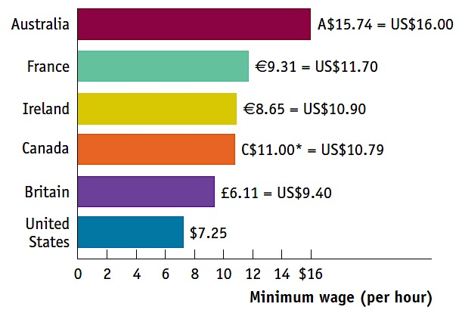
ILLEGAL ACTIVITY
Price floors encourage black markets.
There are willing sellers (and buyers) at illegal prices, so they are tempted to break the law and trade with each other.
In Spain it’s estimated that 1/3 of the “unemployed” have under-the-table jobs.
SOURCE: ORGANIZATION FOR ECONOMIC COOPERATION AND DEVELOPMENT (OECD). 2013

Slide 40
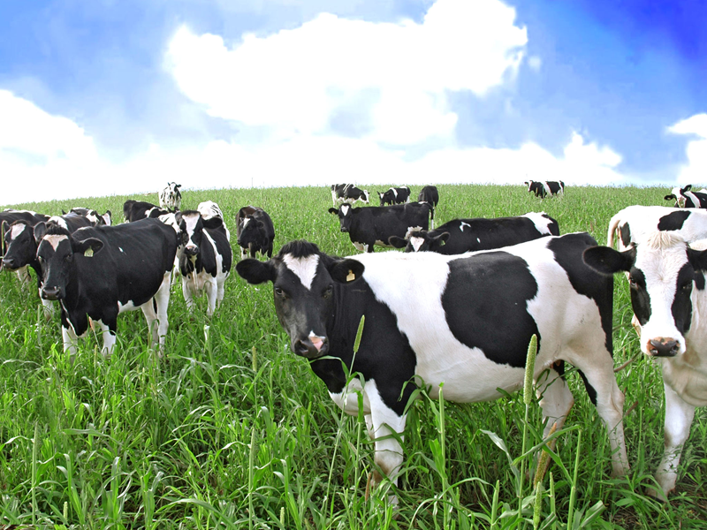
SO WHY ARE THERE PRICE FLOORS?
Same as price ceilings:
They do benefit some people (who are typically better organized and more vocal than those who are harmed by them).
If the price floor is longstanding, buyers may not have a realistic idea of what would happen without it.
Government officials often do not understand supply and demand analysis.
Notes:
All image credits courtesy of Morgue File and/or FreeImages.com unless otherwise specified

Slide 41
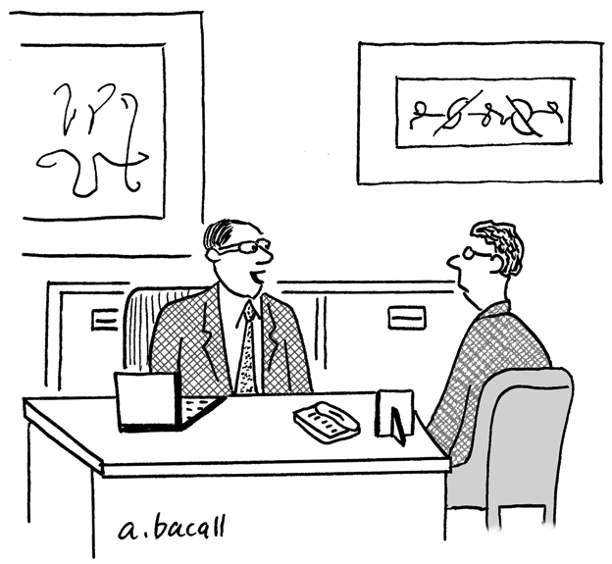
THE RISE AND FALL OF THE UNPAID INTERN
What keeps firms from abusing this practice?
2010 new Dep’t of Labor rules: unpaid internships must be:
Primarily for the benefit of the intern and not the employer
Comparable to training offered by an educational environment
No displacement of a regular employee by the intern
“We have an opening for a part-time unpaid intern, which
could lead to a full-time unpaid internship.”
Notes:
Art courtesy of Aaron Bacall/www.Cartoonstock.com

Slide 42
Don’t be confused: price ceilings , floors and quotas all decrease the amount traded and therefore create deadweight loss.
  A price ceiling pushes the price of a good down; fewer sellers will want to sell.
  A price floor pushes the price of a good up; fewer buyers will want to buy.
  A quota, by definition, reduces sales.
If sellers don’t want to sell as much as buyers want to buy, it’s the sellers who determine the actual quantity sold, because buyers can’t force unwilling sellers to sell and vice versa.

Slide 43
CONTROLLING QUANTITIES
Governments sometimes control quantity instead of price.
  Quota: an upper limit, set by the government, on the quantity of some good that can be bought or sold; also referred to as a quantity control.
  Quota limit: the total amount of a good under a quota or quantity control that can be legally transacted.
  License: the right, conferred by the government, to supply a good.

Slide 44
THE MARKET FOR TAXI RIDES IN THE ABSENCE OF GOVERNMENT CONTROLS
Fare
(per ride)
Quantity of rides
(millions per year)
Fare
Quantity demanded
Quantity supplied
(per ride)
S
$7.00
6
14
$7.00
6.50
$
6.50
7
13
6.00
$
6.00
8
12
5.50
$
5.50
9
11
E
$
5.00
10
10
5.00
$
4.50
11
9
4.50
$
4.00
12
8
4.00
$
3.50
13
7
3.50
$
3.00
14
6
3.00
D
0
6
7
8
9
10
11
12
13
14
Quantity of rides (millions per year)

Slide 45
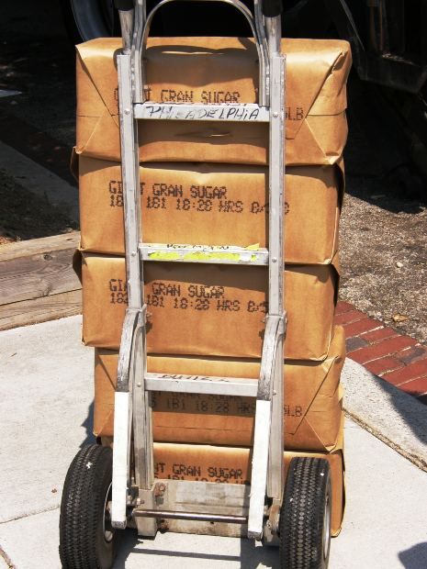
With a partner, choose either to
defend the United States’ sugar import quotas or
attack them.
Imagine you are a young congressional staffer charged with collecting arguments to use for your side in Congress.
Brainstorm two or more arguments you would use and be ready to share.
To Next
Active Learning
Notes:
All image credits courtesy of Morgue File and/or FreeImages.com unless otherwise specified

Slide 46
EFFECT OF A QUOTA ON THE MARKET FOR TAXI RIDES
Fare
(per ride)
Quantity of rides
(millions per year)
Fare
Quantity demanded
Quantity supplied
(per ride)
$7.00
S
$7.00
6
14
6.50
A
$
6.50
7
13
6.00
$
6.00
8
12
5.50
E
$
5.50
9
11
5.00
$
5.00
10
10
4.50
$
4.50
11
9
4.00
B
$
4.00
12
8
3.50
$
3.50
13
7
3.00
D
$
3.00
14
6
Quota
0
6
7
8
9
10
11
12
13
14
Quantity of rides (millions per year)

Slide 47
EFFECT OF A QUOTA ON THE MARKET FOR TAXI RIDES
Fare
(per ride)
Demand price: the price of a given quantity at which consumers will
demand that quantity.
$7.00
Deadweight loss
S
6.50
A
6.00
5.50
E
5.00
4.50
Supply price: the price of a given quantity at which producers will supply that quantity.
4.00
B
3.50
3.00
D
Quota
0
6
7
8
9
10
11
12
13
14
Quantity of rides (millions per year)

Slide 48
EFFECT OF A QUOTA ON THE MARKET FOR TAXI RIDES
Fare
(per ride)
$7.00
Deadweight loss
S
The Wedge, or Quota, rent: the difference between the demand price and the supply price at the quota limit. Equal to the market price of the license when the license is traded.
6.50
A
6.00
5.50
The wedge
E
5.00
4.50
4.00
B
3.50
3.00
D
Quota
0
6
7
8
9
10
11
12
13
14
Quantity of rides (millions per year)

Slide 49
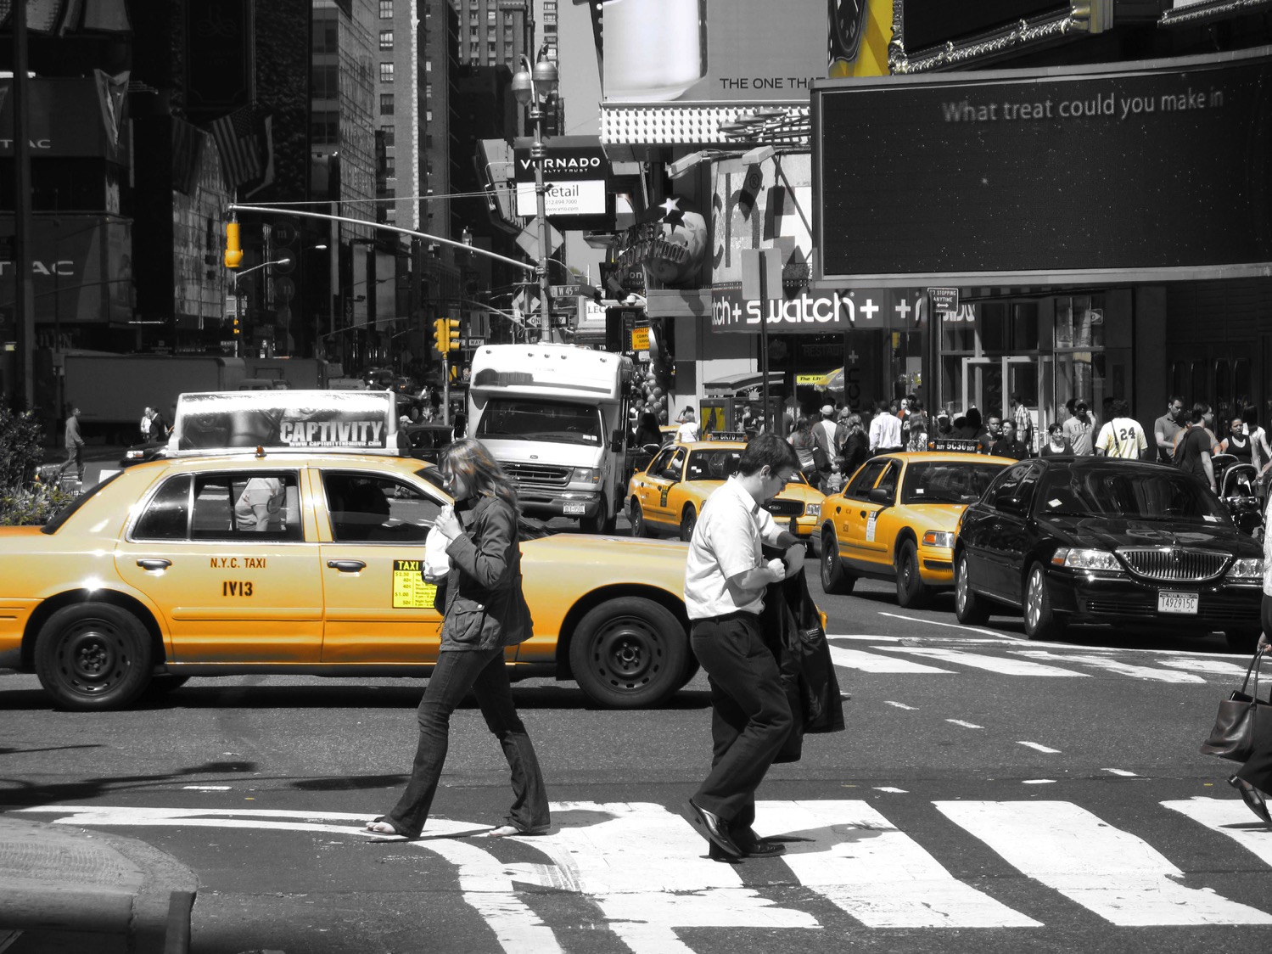
THE COSTS OF QUANTITY CONTROLS
Like price controls, quotas impose losses on society.
Deadweight loss (some mutually beneficial transactions don’t occur)
Incentives for illegal activities
Unlicensed cabs are a side effect of quantity controls… but also an opportunity for alternate models like Über.
Notes:
All image credits courtesy of Morgue File and/or FreeImages.com unless otherwise specified

Slide 50
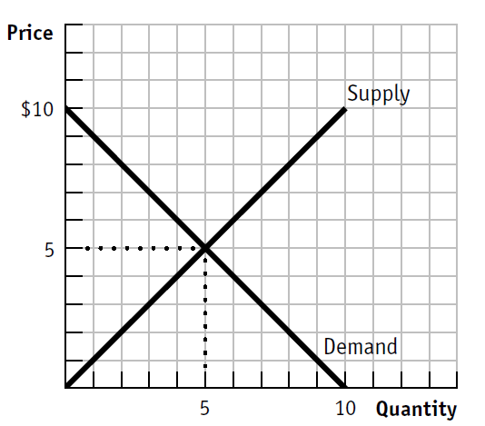
What is the consumer surplus if the market is allowed to be at equilibrium?
$50
$25
$12.50
$5
To Next
Active Learning

Slide 51
What is the producer surplus if the market is allowed to be at equilibrium?
$50
$25
$12.50
$5
To Next
Active Learning

Slide 52
What is the deadweight loss if the government were to limit sales to 3?
$8
$6
$4
$3
To Next
Active Learning

Slide 53
What is the value of the quota rent if the quota is set to 2 units?
$8
$6
$4
$3

