Slide 1
Notes:
All image credits courtesy of Morgue File and/or FreeImages.com unless otherwise specified

Slide 3
What consumer surplus is and its relationship to the demand curve
What producer surplus is and its relationship to the supply curve
What total surplus is and how it can be used both to measure the gains from trade and to illustrate why markets work so well
Why property rights and prices as economic signals are critical to smooth functioning of a market
Why markets typically lead to efficient outcomes despite the fact that they sometimes fail
To Active
Learning
To Video

Slide 4
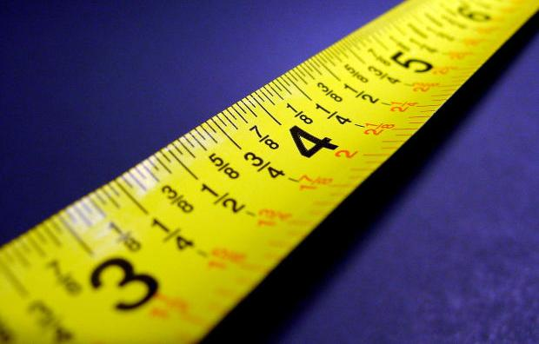
MEASURING MARKET EFFICIENCY
Markets are (usually) efficient: we can measure their benefit to society by measuring:
consumer surplus.
producer surplus.
4-
4
Notes:
All image credits courtesy of Morgue File and/or FreeImages.com unless otherwise specified

Slide 5
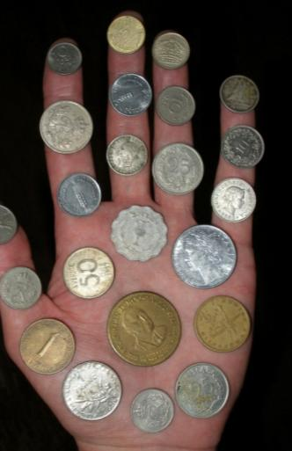
CONSUMER SURPLUS
Consumer surplus: the difference between market price and what consumers (as individuals or the market) would be willing to pay.
Notes:
All image credits courtesy of Morgue File and/or FreeImages.com unless otherwise specified

Slide 6
THE DEMAND CURVE FOR USED TEXTBOOKS
Price of book
$59
Aleisha
Potential buyers
Willingness to pay
Aleisha
$59
45
Brad
Brad
45
Claudia
35
35
Claudia
Darren
25
Edwina
10
25
Darren
A consumer’s willingness to pay for a good is the maximum price at which he or she would buy that good.
10
Edwina
D
0
1
2
3
4
5
Quantity of books
Notes:
Figure Caption:
Figure 4-1: The Demand Curve for Used Textbooks
With only five potential consumers in this market, the demand curve is step-shaped. Each step represents one consumer, and its height indicates that consumer’s willingness to pay—the maximum price at which each will buy a used textbook—as indicated in the table. Aleisha has the highest willingness to pay at $59, Brad has the next highest at $45, and so on down to Edwina with the lowest willingness to pay at $10. At a price of $59, the quantity demanded is one (Aleisha); at a price of $45, the quantity demanded is two (Aleisha and Brad); and so on until you reach a price of $10, at which all five students are willing to purchase a book.

Slide 7
CONSUMER SURPLUS
Price of book
Aleisha’s consumer surplus:
$59 – $30 = $29
$59
Aleisha
Brad’s consumer surplus:
$45 – $30 = $15
The total consumer surplus is the entire shaded area—the sum of the individual consumer surpluses of Aleisha, Brad, and Claudia ($29 + $15 + $5 = $49).
45
Brad
Claudia’s consumer surplus: $35 – $30 = $5
35
Claudia
30
Price = $30
25
Darren
10
Edwina
D
0
1
2
3
4
5
Quantity of books

Slide 8
George is considering the purchase of some new shirts for work. He is willing to pay $35
for the first shirt, $25 for the second shirt, and $15 for the third. Oxford Clothiers, his
favorite shirt manufacturer, is selling shirts for $28 each. What is the efficient number of shirts for George to buy? What is George’s consumer surplus?
Explain your answers.
To Next
Active Learning

Slide 9
CONSUMER SURPLUS
Consumer surplus is the area beneath the demand curve and above the price.
Price of widgets
Area of triangle
Height
80
Total consumer surplus at a price of $20
½(base x height)
Base
½(80 – 20) × 90 = $2,700
20
D
90
Quantity of widgets
Notes:
Teaching Tip:You can easily personalize consumer surplus. Look for a student
with a Coke, coffee, or water. Ask how much he or she paid for it.
Then ask if that was the maximum they would have paid or if the store
had been charging a little more would they still have bought it. They likely
will admit they still would have bought it.Then ask what is the maximum
price they would have paid before walking away without buying. Calculate
their consumer surplus from the transaction and relate this to how it
would be measured on a demand diagram.

Slide 10
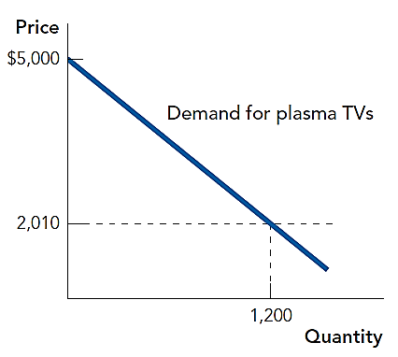
If the price is $2010, what is the consumer surplus?
$3.588 million
$1.794 million
$6 million
$3 million
To Next
Active Learning

Slide 11
CONSUMER SURPLUS RISES WITH A FALL IN PRICE
Price of book
Original buyers get an increase in consumer surplus, and new buyers add more consumer surplus.
Increase in Aleisha’s consumer surplus
$59
Aleisha
Increase in Brad’s consumer surplus
45
Brad
Increase in Claudia’s consumer surplus
35
Claudia
30
Original price = $30
25
Darren
20
New price = $20
Darren’s consumer surplus
10
Edwina
D
0
1
2
3
4
5
Quantity of books

Slide 12
HOW THE GAINS IN CONSUMER SURPLUS ARE SPLIT
Price of computers
Increase in consumer surplus to original buyers
$5,000
Consumer surplus gained by new buyers
1,500
D
0
200,000
1 million
Quantity of computers

Slide 13
THE SUPPLY CURVE FOR USED TEXTBOOKS
Price of book
Potential sellers
S
Cost
Andrew
$5
$45
Engelbert
Donna
15
Carlos
25
35
Donna
35
Betty
Engelbert
45
25
Carlos
15
Betty
5
Andrew
0
1
2
3
4
5
Quantity of books
Notes:
Figure Caption:
Figure 4-6: The Supply Curve for Used Textbooks
The supply curve illustrates sellers’ cost, the lowest price at which a potential seller is willing to sell the good, and the quantity supplied at that price. Each of the five students has one book to sell and each has a different cost, as indicated in the accompanying table. At a price of $5 the quantity supplied is one (Andrew), at $15 it is two (Andrew and Betty), and so on until you reach $45, the price at which all five students are willing to sell.

Slide 14
Seller’s minimum price to sell (= the seller’s opportunity cost) | Actual market price for tutoring | Producer surplus
Jane’s price = $12 | $10 | n/a
Dora’s price = $10 | $10 | $0
Lee’s price = $8 | $10 | $2
Sam’s price = $6 | $10 | $4
Kathy’s price = $4 | $10 | $6
Seller’s minimum price to sell (= the seller’s opportunity cost) | Actual market price for tutoring | Producer surplus
Jane’s price = $12 | $10
Dora’s price = $10 | $10
Lee’s price = $8 | $10
Sam’s price = $6 | $10
Kathy’s price = $4 | $10
Calculate the producer surplus for each seller.
To Next
Active Learning

Slide 15
PRODUCER SURPLUS
Producer surplus: the difference between market price and the price at which firms are willing to supply the product.
Notes:
All image credits courtesy of Morgue File and/or FreeImages.com unless otherwise specified

Slide 16
PRODUCER SURPLUS
Price of book
S
$45
Engelbert
35
Donna
30
Price = $30
25
Carlos’s producer surplus
Carlos
15
Betty
Betty’s producer surplus
Andrew’s producer surplus
5
Andrew
0
1
2
3
4
5
Quantity of books

Slide 17
PRODUCER SURPLUS
The total producer surplus from sales of a good at a given price is the area above the supply curve but below that price.
Price of wheat (per bushel)
S
$5
Price = $5
Producer surplus
0
1 million
Quantity of wheat (bushels)
Notes:
Figure Caption:
Figure 4-8: Producer Surplus
Here is the supply curve for wheat. At a price of $5 per bushel, farmers supply 1 million bushels. The producer surplus at this price is equal to the shaded area: the area above the supply curve but below the price. This is the total gain to producers— farmers in this case—from supplying their product when the price is $5.

Slide 18
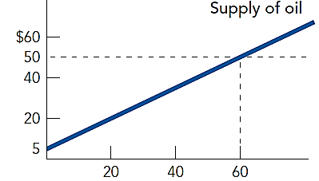
Using the following diagram, calculate total producer surplus if the price of oil is $50 per barrel.
0
$45
$1,350
$2,700
Price
Quantity of Oil
(Millions of Barrels per day)
To Next
Active Learning

Slide 19
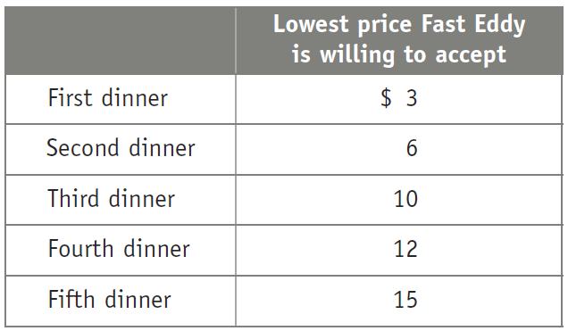
If a dinner at Fast Eddy’s tonight sells for $13, what is the value of Fast Eddy’s producer surplus?
$10
$17
$20
$21
To Next
Active Learning

Slide 20
PRODUCER SURPLUS RISES IF THE PRICE INCREASES
Price of wheat (per bushel)
Increase in producer surplus to original sellers
Producer surplus gained by new sellers
S
$7
5
0
1 million
1.5 million
Quantity of wheat (bushels)

Slide 21
TOTAL SURPLUS IS MAXIMIZED AT MARKET EQUILIBRIUM
Total surplus: the sum of the producer and consumer surpluses.
Price of book
S
Consumer surplus
Equilibrium price
E
$30
Producer surplus
D
0
1,000
Quantity of books
Equilibrium quantity

Slide 22
Total Surplus is Maximized at Market Equilibrium
What is the total surplus when price is at equilibrium?
$480
$720
$1,080
$1,440
$22
S
Price of Lobster
E
10
4
D
0
120
Quantity of lobster
To Next
Active Learning
Notes:
(22-4)/2 = 1080

Slide 23
With a partner, discuss and be ready to share:
Are you in favor of legalizing the sale of kidneys? Why or why not?
Do you support the move to distribute organs in the United States based on “net benefit” rather than simply who’s been on the waiting list longest? Why or why not?
To Next
Active Learning

Slide 24
THREE WAYS YOU MIGHT (UNSUCCESSFULLY) TRY TO INCREASE THE TOTAL SURPLUS
reallocate consumption among consumers
reallocate sales among sellers
change the quantity traded
Notes:
All image credits courtesy of Morgue File and/or FreeImages.com unless otherwise specified

Slide 25
WHY REALLOCATING CONSUMPTION LOWERS CONSUMER SURPLUS
Price of book
Loss in consumer surplus if the book is taken from Ana and given to Bob
S
It’s worth $25
It’s worth $35
A
$35
E
30
B
25
D
0
1,000
Quantity of books
Notes:
All image credits courtesy of Morgue File and/or FreeImages.com unless otherwise specified

Slide 26
Why Reallocating Sales Lowers Producer Surplus
I’d sell it for $25 minimum.
Price of book
I’d take no less than $35.
S
Y
$35
E
Loss in producer surplus if Yvonne is made to sell the book instead of Xavier
30
X
25
D
0
1,000
Quantity of books
Notes:
All image credits courtesy of Morgue File and/or FreeImages.com unless otherwise specified

Slide 27
WHY CHANGING THE QUANTITY LOWERS TOTAL SURPLUS
Price of book
Loss in total surplus if the transaction between Ana and Xavier is prevented
S
A
Y
$35
Loss in total surplus if the transaction between Yvonne and Bob is forced
E
30
25
X
B
D
0
1,000
Quantity of books

Slide 28
THE EFFICIENCY OF MARKETS
Competitive markets are usually efficient:
They allocate consumption of the good to the potential buyers who most value it.
They allocate sales to the potential sellers who most value the right to sell the good (e.g., who have the lowest cost).
They ensure that all transactions are mutually beneficial: Every consumer who makes a purchase values the good more than every seller who makes a sale.

Slide 29
EQUITY AND EFFICIENCY
Efficiency is important, but society also cares about equity.
Sometimes societies choose to have governments intervene in markets to increase efficiency (even though it reduces efficiency).
Notes:
All image credits courtesy of Morgue File and/or FreeImages.com unless otherwise specified

Slide 30
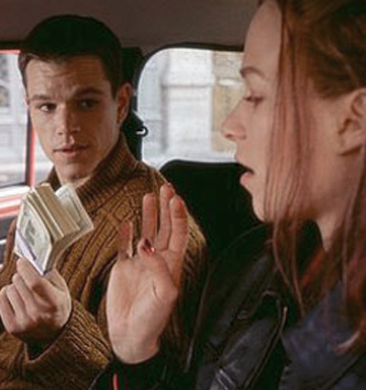
This scene from The Bourne Identity shows how trade creates consumer and producer surplus. Click here or on the picture. (2 minutes)
Copyright 2015 Worth Publishers
Notes:
http://movieclips.com/xYEyV-the-bourne-identity-movie-you-need-money-i-need-a-ride/

Slide 31
WHY MARKETS TYPICALLY WORK SO WELL
Well-functioning markets are effective because of:
property rights.
economic signals.

Slide 32
In your opinion, which is the best way for society to distribute its goods?
The free market outcome should not be tampered with.
“From each according to his ability; to each according to his need.”
Distribute goods so that society’s total happiness is maximized, even if it requires taking some from the wealthiest to give to the poorest.
To Next
Active Learning
Notes:
No right answer. A represents Nozick’s libertarian theory, B represents Marx’s (and general Socialist sentiment of) equality, C represents the Utilitarian idea.

Slide 33
WHY PRIVATE PROPERTY MATTERS
Private property rights create and protect incentives to trade with others—and to innovate.
Notes:
All image credits courtesy of Morgue File and/or FreeImages.com unless otherwise specified

Slide 34
WHY GOOD ECONOMIC SIGNALS MATTER
Equilibrium prices signal to resources exactly where they are most valued.
Notes:
All image credits courtesy of Morgue File and/or FreeImages.com unless otherwise specified

Slide 35
WHY GOOD ECONOMIC SIGNALS MATTER
Prices translate complex information into an easy signal for producers:
Profits rise in industries when consumers want more of that industry’s products.
Profits decline in industries when consumers want less of that industry’s products.
The high price of ice in post-Katrina New Orleans made it more attractive for firms to provide ice where society needed it most.
Notes:
All image credits courtesy of Morgue File and/or FreeImages.com unless otherwise specified

Slide 36
Think, pair, share:
Discuss with your neighbor: Are you in favor of “price gouging” (charging what the market will bear) during natural disasters?
Why or why not?
Notes:
This type of exercise takes just a few minutes: get students to pair up, discuss the question with their partner and then be prepared to share their combined ideas to the class. Call on volunteers and non-volunteers to mix it up.

Slide 37
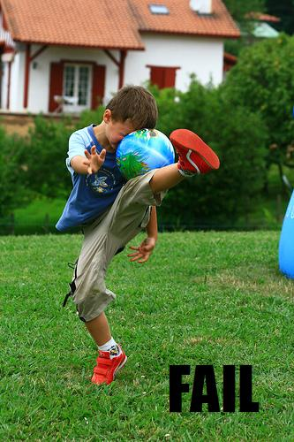
A FEW WORDS OF CAUTION
Markets aren’t always efficient; sometimes they fail.
Inefficient: Opportunities are missed. Some people could be made better off without making other people worse off.
We’ll learn more about market failures later.
Notes:
All image credits courtesy of Morgue File and/or FreeImages.com unless otherwise specified

