Slide 3
A set of principles for understanding the economics of how individuals make choices
A set of principles for understanding how economies work through the interaction of individual choices
A set of principles for understanding economy-wide interactions
To First
Active Learning
To Video
Copyright 2016 Worth Publishers

Slide 4
CHOICE: THE HEART OF ECONOMICS.
She must choose. And her choice affects others.

Slide 5
INDIVIDUAL CHOICE: THE PRINCIPLES
1. Choices are necessary because resources are scarce.

Slide 6
RESOURCES AND SCARCITY
Resource: anything that can be used to produce something else.
Scarce: in short supply; a resource is scarce when there is not enough of the resource available to satisfy all the various ways a society wants to use it.

Slide 7
INDIVIDUAL CHOICE: THE PRINCIPLES
2. The true cost of something is its opportunity cost.
Opportunity cost: what you must give up in order to get something.
Mark Zuckerberg understood the concept of opportunity cost—and dropped out of Harvard.

Slide 8
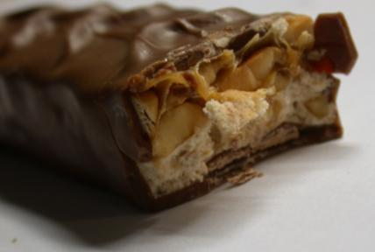
INDIVIDUAL CHOICE: THE PRINCIPLES
3. “How much” is a decision at the margin.
Trade-off: comparison of the costs and the benefits of doing something.
Each bite of the candy bar has costs and benefits.

Slide 9
INDIVIDUAL CHOICE: THE PRINCIPLES
Marginal decision: decision made at the margin of an activity about whether to do a bit more or a bit less of that activity.
Marginal analysis: the study of marginal decisions.
Incentive: anything that offers rewards to people who change their behavior.

Slide 10
New York City Mayor Michael Bloomberg proposed a ban on the sale of any sugary beverage over 16 ounces in any of the city's restaurants, delis, movie theaters, and street carts.
“Obesity is a nationwide problem, and all over the United States, public health officials are wringing their hands saying, ‘Oh, this is terrible.’ New York City is not about wringing your hands; it’s about doing something. I think that’s what the public wants the mayor to do,” Bloomberg told The New York Times in making his proposal.
Discuss: Do you agree that soda should be taxed or banned? Why or why not?
To Next
Active Learning
Notes:
This is a good ice-breaker for students. An effective way to discuss is via “Think, Pair, Share,” where students are asked to jot down their ideas for a minute or two, then form a pair with their neighbor, discuss with him or her, and finally be ready to share with the entire class.

Slide 11
INDIVIDUAL CHOICE: THE PRINCIPLES
4. People usually respond to incentives, exploiting opportunities to make themselves better off.
In the United States, restaurant customers have the option of adding a tip to the restaurant bill. In much of Europe a tip is added automatically.
Where would you expect waiters to be more attentive?

Slide 12
CAN YOU SPOT THE PROBLEM WITH THIS INCENTIVE SYSTEM?
A juvenile prison in Pennsylvania offered judges bribes the more young people they sent to jail.
One teen was jailed for a Facebook page that was critical of her high-school principal.
Both judges pleaded guilty to accepting $2.6 million in bribes.
To Next
Active Learning

Slide 13
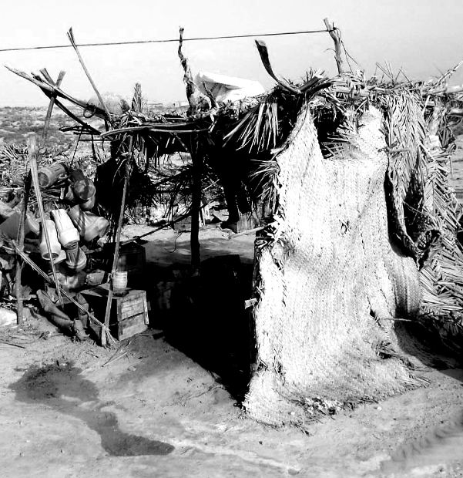
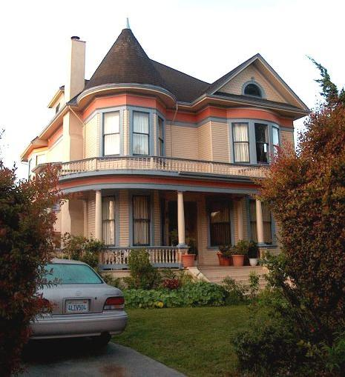
INTERACTION AND INDIVIDUAL CHOICE
5. There are gains from trade.
Trade allows us all to consume more than we otherwise could.

Slide 14
INTERACTION AND INDIVIDUAL CHOICE
Specialization: the situation in which each person specializes in the task that he or she is good at performing.

Slide 15
INTERACTION AND INDIVIDUAL CHOICE
6. Markets move toward equilibrium.
Equilibrium: an economic situation in which no individual would be better off doing something different.

Slide 16
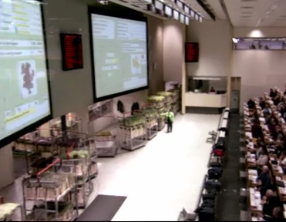
Take a look…
For a look at a real-world equilibrium, click the picture below to see the Aalsmeer Dutch Tulip auction in action. (3 minutes)
Notes:
http://video.kera.org/video/1283843915/

Slide 17
Lane speeds reach equilibrium quickly as people respond to incentives.

Slide 18
INTERACTION AND INDIVIDUAL CHOICE
7. Resources should be used efficiently
to achieve society’s goals.
Efficient: taking all opportunities to make some people better off without making other people worse off.

Slide 19
INTERACTION AND INDIVIDUAL CHOICE
Equity: a condition in which everyone gets his or her “fair share.”
(There are many definitions of equity.)
EQUITY AND EFFICIENCY ARE OFTEN AT ODDS.
Equity trumps efficiency in disabled parking space offerings.

Slide 20
INTERACTION AND INDIVIDUAL CHOICE
8. Markets usually lead to efficiency.
People normally take opportunities for mutual gain.

Slide 21
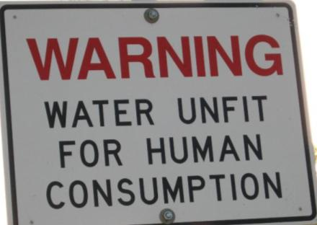
INTERACTION AND INDIVIDUAL CHOICE
9. When markets don’t achieve efficiency,
government intervention can improve society’s welfare.
Sometimes markets fail and need correction.

Slide 22
ECONOMY-WIDE INTERACTIONS
10. One person’s spending is another person’s income.

Slide 23
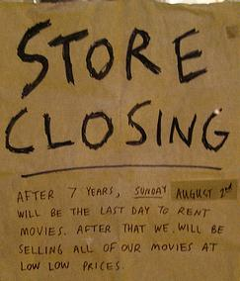
ECONOMY-WIDE INTERACTIONS
During recessions, a drop in business spending leads to:
Less income,
less spending…
…and further drops in business spending, layoffs, and rising unemployment.

Slide 24
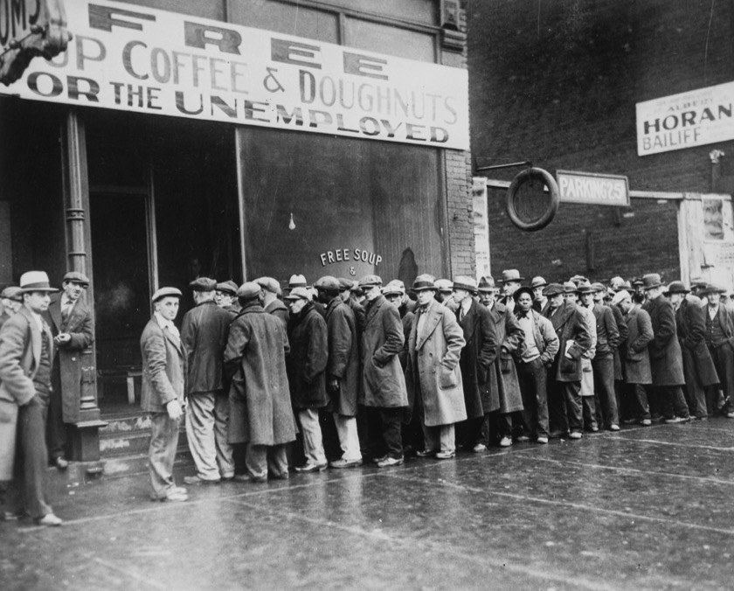
ECONOMY-WIDE INTERACTIONS
11. Overall spending sometimes gets out of line with the economy’s productive capacity.

Slide 25
ECONOMY-WIDE INTERACTIONS
12. Government policies can change spending.
The U.S. government funded the WPA and provided almost 8 million jobs between 1935 and 1943.

